Slide 1
Comunidad Foral de Navarra
PO 2014-2020
Presentación Buena Práctica de Actuación Cofinanciada
FEDER
Acto Anual de Comunicación 2019
Madrid, 25 y 26 Noviembre

Slide 2
PROGRAMA OPERATIVO FEDER 2014-2020 DE NAVARRA
EJE PRIORITARIO 1
OBJETIVO TEMÁTICO: | OT 1. POTENCIAR LA INVESTIGACIÓN, EL DESARROLLO TECNOLÓGICO Y LA INNOVACIÓN
PRIORIDAD INVERSIÓN: | PI 1.2: Fomento de la inversión empresarial en I+i, desarrollo de vínculos y sinergias entre las empresas, los centros de investigación y desarrollo y el sector de la enseñanza superior, en particular mediante el fomento de la inversión en el desarrollo
Objetivo Específico: | OE 1.2.1: Impulso y promoción de actividades de I+i lideradas por las empresas, apoyo a la creación y consolidación de empresas innovadoras y apoyo a la compra pública innovadora
LÍNEA DE “AYUDAS A PROYECTOS DE I+D”, CONVOCATORIA 2015.
Sector de la BIOMEDICINA.

Slide 3

New Medicines based on the Adenosine Receptors Modulation
Dr. Julio Castro (CEO)
Acto Anual de Política Regional y Fondos Europeos en España
Madrid, 25 y 26 de Noviembre de 2019

Slide 4
Palobiofarma: Introduction
Spanish Biotech company founded in 2006 and based in Navarre
Mision: Discovery of new medicines dealing with modulators of the adenosine receptors
Vision: Discover the first marketed drug based on a selective adenosine receptor modulator
VC-backed since 2010, with a total of 4 Mio € raised in three financing rounds
Focus on Medicinal Chemistry capabilities

Slide 5
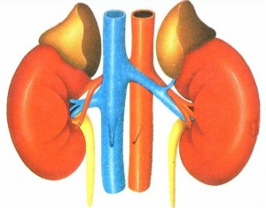



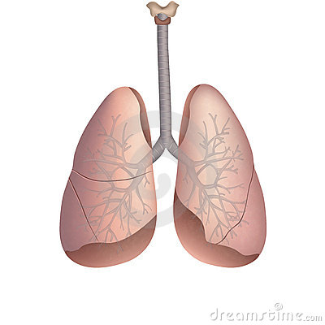
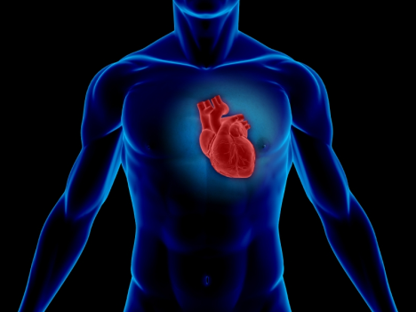
Adenosine Receptors as Therapeutic Targets: Challenges
Broad CNS effects
Broad renal effects
Broad CV effects
Broad pulmonary effects

Slide 6
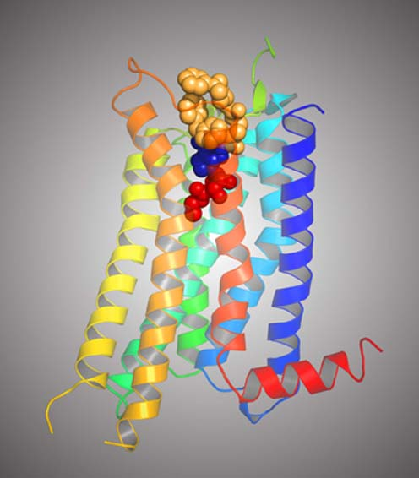
Opportunity: Structure-based design
The determination of X-ray structures of Adenosine A2a receptor has made these targets accessible to structure-based ligand discovery
2008; Stevens et al
Bound to the Antagonist
ZM 241,385
2011; Stevens et al
Bound to the Agonist
UK 432, 097
2011; Heptares
Bound to several
Agonists and Antagonists

Slide 7
Company Assets
Using the structure-based approach we have been able to generate over the past 10 years following assets:
Proprietary compound library with over 4000 compounds targeting adenosine receptors
Broad intellectual property covering novel classes of selective adenosine receptor modulators
Validated Pharmacophore model for each receptor
Seven drug discovery programs generated 6 development candidates in five different therapeutic indications

Slide 8



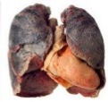

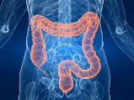
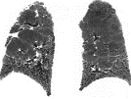
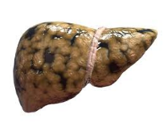
Robust Clinical Pipeline of Adenosine Receptor Antagonists
PBF-680: A₁ antagonist
Asthma/COPD.
Phase II in progress
PBF-509: A_{2A} antagonist
Lung Cancer
Phase II in progress
PBF-999: PDE-10 inhibitor
Solid Tumors
Phase I in progress
PBF-677: A₃ antagonist
IBD
Phase II in progress
PBF-1129: A_{2B} antagonist
Pulmonary Fibrosis & Lung Cancer
Phase I in cancer in progress
PBF-1650: A₃ antagonist
Psoriasis
Phase I HV in progress

Slide 9
Robust Clinical Pipeline of Adenosine Receptor Antagonists
PBF-680: A₁ antagonist
Asthma/COPD.
Phase II in progress
PBF-509: A_{2A} antagonist
Lung Cancer
Phase II in progress
PBF-999: PDE-10 inhibitor
Solid Tumors
Phase I in progress
PBF-677: A₃ antagonist
IBD
Phase II in progress
PBF-1129: A_{2B} antagonist
Pulmonary Fibrosis & Lung Cancer
Phase I in cancer in progress
PBF-1650: A₃ antagonist
Psoriasis
Phase I HV in progress

Slide 10

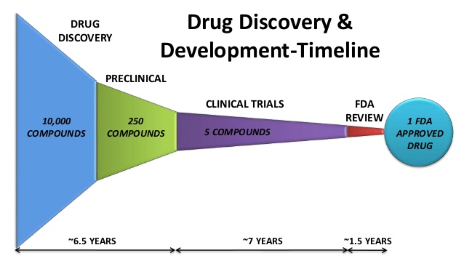
Key financial support
PBF-677

Slide 11


MUCHAS GRACIAS!!!

