Slide 1


Innovación, redes y conocimiento
en las regiones Europeas
Rosina Moreno
AQR-IREA Research Group. Universitat de Barcelona

Slide 2

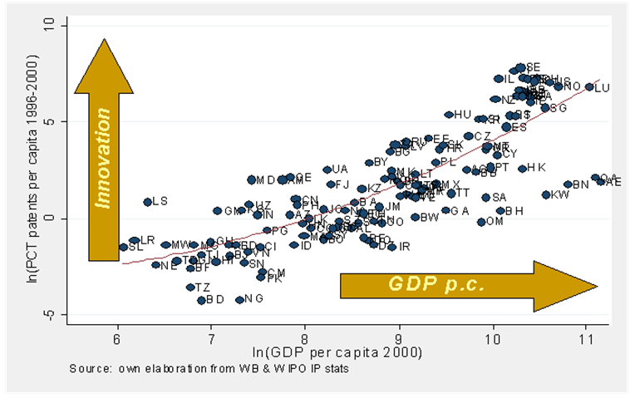
Motivation. Is innovation relevant?
The production of ideas, knowledge and innovations drives the economic development of countries and nations
Theoretical models: Schumpeter (1934); Jones (1995); Anghion&Howitt (1998)
Data:
Policy in the EU: Knowledge and innovation are recognized to be the strategic assets to build a “smart growth” in Europe (SS3, European Commission).

Slide 3



Motivation
Media
Change in the educational model: “learn to learn”

Slide 4
Motivation. How is knowledge produced?
  Large part of new knowledge production is the result of the combination and recombination of already existing ideas (Dosi, 1988)
  Endogenous growth models:
    Knowledge is a public good, non-rival and non-excludable
    Resulting knowledge spillovers are the engine of sustained economic growth (Romer, 1986, 1990; Lucas, 1988; Grossman and Helpman, 1991)

Slide 5
Motivation. How is innovation diffused?
Geography of innovation:
  Tacitness of knowledge: relevant knowledge is highly contextual and hard to articulate
  Localized knowledge spillovers became the cornerstone of the geography of innovation literature (Jaffe, 1986; Audretsch&Feldman, 1996)
    Only by being co-located in the same geographical space, agents are exposed to ceaseless inflows of information and learning opportunities. Example of Silicon Valley (f2f contacts)
    Multiple attempts to explain the local diffusion of ideas:
    Industrial districts (Becattini, 1979), clusters (Porter, 1990), local buzz (Storper and Venables, 2004), regional advantage (Saxenian, 1994), collective learning (Camagni, 1991), …

Slide 6
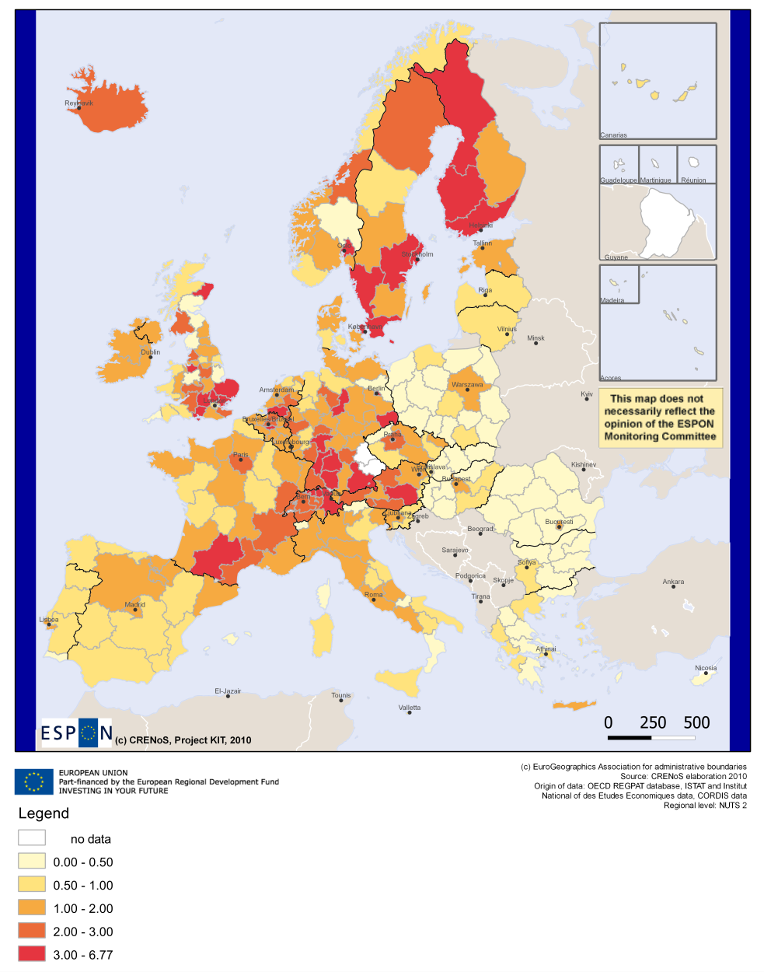
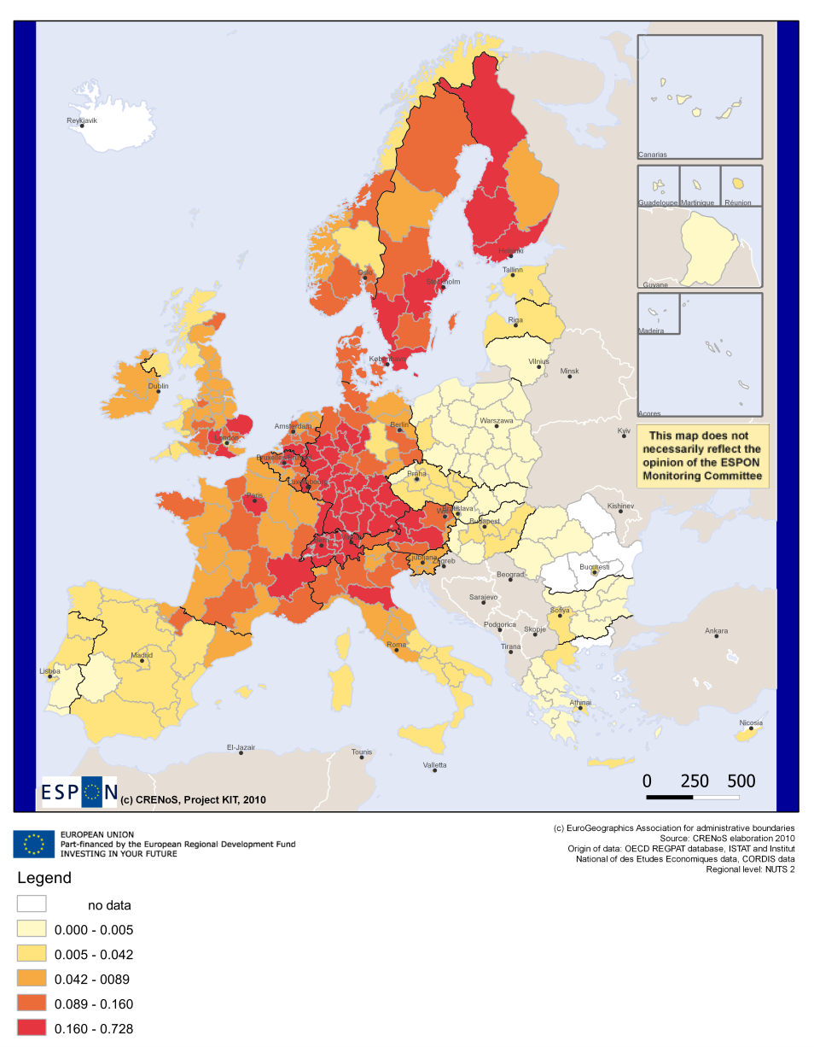
R&D Expenditures on GDP, average 2006-2007
Number of patents per 1000 inhabitants,
average 2005-2006

Slide 8
Motivation. How is innovation diffused?
Geography of innovation:
  Tacitness of knowledge: relevant knowledge is highly contextual and hard to articulate
  Localized knowledge spillovers became the cornerstone of the geography of innovation literature (Jaffe, 1986; Audretsch&Feldman, 1996)
    Only by being co-located in the same geographical space, agents are exposed to ceaseless inflows of information and learning opportunities. Example of Silicon Valley (f2f contacts)
    Multiple attempts to explain the local diffusion of ideas:
    Industrial districts (Becattini, 1979), clusters (Porter, 1990), local buzz (Storper and Venables, 2004), regional advantage (Saxenian, 1994), …

Slide 9
Motivation
Excessively close actors may have little to exchange after a certain amount of interactions.
  Risk to re-combine knowledge that becomes redundant and less valuable: regional ‘lock-in’ (Boschma and Frenken, 2009)
  In some instances, it is not enough by being there to receive knowledge flows : Rather, knowledge flows follows specific transmission channels:
    Based on market interactions (not always as an externality): requires conscious efforts, they are not free. Pecuniary.
    Can be local but can span the boundaries of a region:
      Pipelines to hot spots
      Death of distance because of TIC?

Slide 10
Mobility and Networks: Policy
EUROPEAN POLICY:
The European Research Area (ERA) aims at building an integrated pan-European research and innovation system to facilitate the “free circulation of researchers, knowledge and technology”:
  Greater mobility of researchers within the continent
  Networking of existing centres of excellence in Europe
  Important implications for peripheral European regions

Slide 11
Mobility and Networks: Economic Literature
ECONOMIC LITERATURE
Relation between high-skilled workers mobility and knowledge diffusion:
  When skilled workers move, take their embodied knowledge, share it with new colleagues, and promote new combinations of knowledge (Breschi et al, 2010).
  Theoretical and empirical evidence: Boschma et al., 2009; Magnani, 2006; Oettl & Agrawal, 2008; Singh & Agrawal, 2011.
Networks as a means to diffuse knowledge and promote the cross-pollination of ideas:
  Firms in regions buid pipelines in the form of alliances to benefit from knowledge hotspots around the world (Bathelt et al, 2004; Owen-Smith and Powell, 2004)
  Empirical evidence: Breschi & Lissoni, 2009; Cowan & Jonard, 2004; Gomes-Casseres et al., 2006; Simonen & McCann, 2008; Singh, 2005.

Slide 12
Mobility and Networks in Europe: Three questions
Does mobility of high-skilled workers and networks generate knowledge diffusion and subsequent regional innovation production in EU regions?
Differentiated effects of networks and mobility across groups of regions?
Do region’s absorptive capacity determines networks and mobility returns to innovation?

Slide 13

Empirical strategy
Role of mobility and networking. Regional KPF:
  274 NUTS2 European regions of 27 countries (EU-27 except Cyprus and Malta plus Norway and Switzerland) from 2000 to 2007
  Patent applications per million inh. REGPAT database (January 2010 edit.)
  R&D expenditures per capita (EUROSTAT and Nat Stat Offices)
  Human capital: share of population with tertiary education (EUROSTAT)
  Mobility and Networks: not in official statistics, PATENT DOCUMENTS

Slide 14
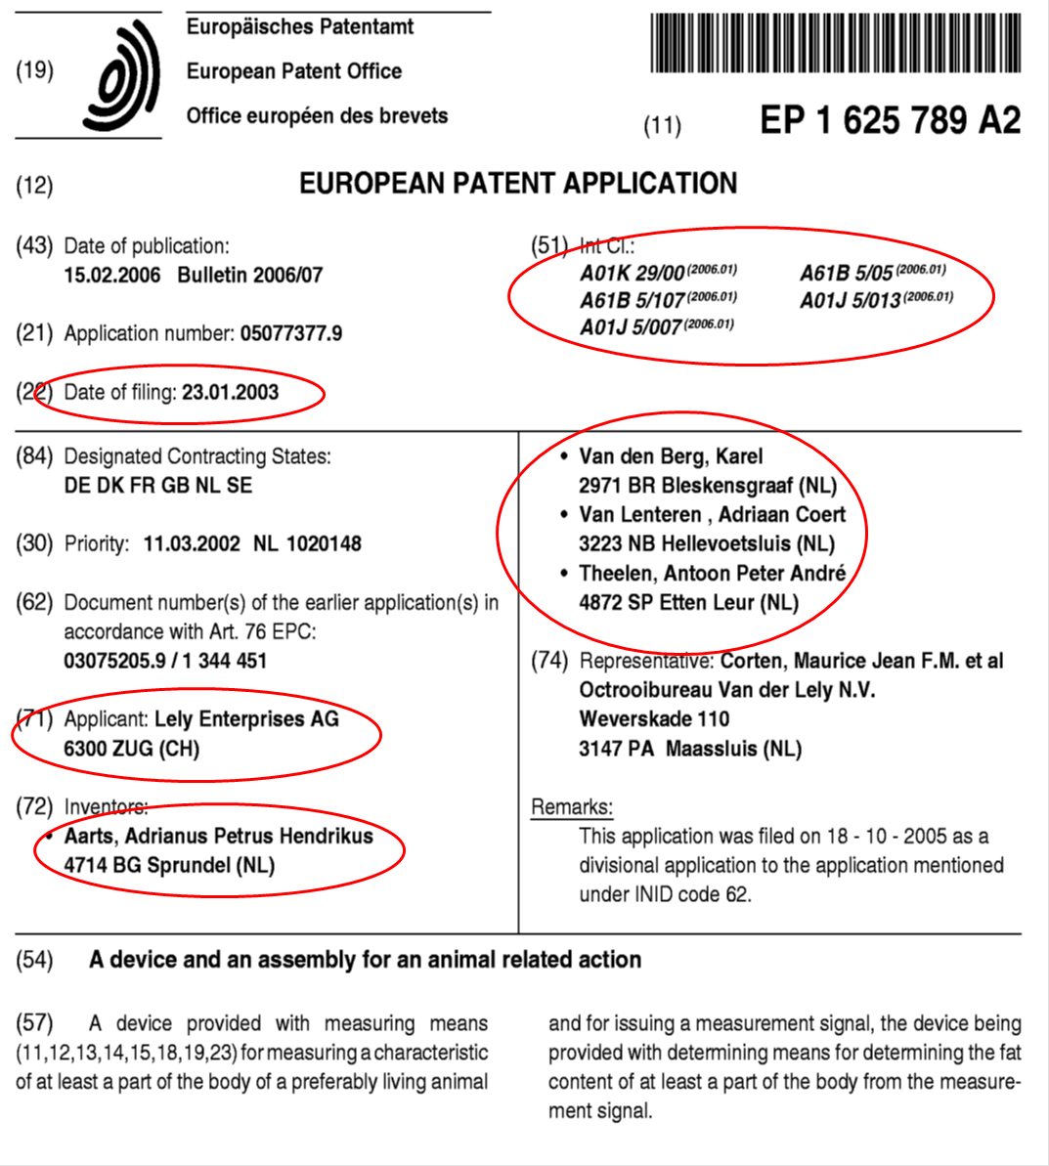

Slide 15
Data
Mobility and network variables
  Use unit-record data from EPO patents (REGPAT, Jan. edit.)
  In- and Out-flows of inventors: changes of the region of residence reported by the inventor in patent documents (within 5 years) divided by number of inventors
  Co-patents between inventors residing, at the time of application, in different regions: average number of co-inventions per inventor from outside the inventor’s region.
  No single ID for each inventor. Need to identify them individually

Slide 16
Results: Patterns of mobility and networking
Mobility |  | Networks
Average distance covered | 395.14km | Average distance covered | 355.48km
Movements from within national borders | 67.87% | Networks from within national borders | 77.48%
% inflows in top 20 regions | 49.76% | % networks in top 20 regions | 49.99%
Gini index inflows’ distribution | 0.73 | Gini index networks’ distribution | 0.73
Regions with 0 inflows | 37 (13.50%) | Regions with 0 networks | 4 (1.46%)
Regions with 5 or less inflows | 84 (30.66%) | Regions with 5 or less networks | 9 (3.28%)
Regions with 0 inflows High-income | 2 (1.16%) | Regions with 0 networks High-income | 0 (0.00%)
Regions with 0 inflows Low-income | 35 (34.65%) | Regions with 0 networks Low-income | 4 (3.96 %)
Distance very small if compared with average distance between all pairs: 1787 km.

Slide 17
Results: Patterns of mobility and networking
Mobility |  | Networks
Average distance covered | 395.14km | Average distance covered | 355.48km
Movements from within national borders | 67.87% | Networks from within national borders | 77.48%
% inflows in top 20 regions | 49.76% | % networks in top 20 regions | 49.99%
Gini index inflows’ distribution | 0.73 | Gini index networks’ distribution | 0.73
Regions with 0 inflows | 37 (13.50%) | Regions with 0 networks | 4 (1.46%)
Regions with 5 or less inflows | 84 (30.66%) | Regions with 5 or less networks | 9 (3.28%)
Regions with 0 inflows High-income | 2 (1.16%) | Regions with 0 networks High-income | 0 (0.00%)
Regions with 0 inflows Low-income | 35 (34.65%) | Regions with 0 networks Low-income | 4 (3.96 %)
Distribution of flows and networks very skewed. Networks reach a larger number of regions.

Slide 18
Results: Patterns of mobility and networking
Mobility |  | Networks
Average distance covered | 395.14km | Average distance covered | 355.48km
Movements from within national borders | 67.87% | Networks from within national borders | 77.48%
% inflows in top 20 regions | 49.76% | % networks in top 20 regions | 49.99%
Gini index inflows’ distribution | 0.73 | Gini index networks’ distribution | 0.73
Regions with 0 inflows | 37 (13.50%) | Regions with 0 networks | 4 (1.46%)
Regions with 5 or less inflows | 84 (30.66%) | Regions with 5 or less networks | 9 (3.28%)
Regions with 0 inflows High-income | 2 (1.16%) | Regions with 0 networks High-income | 0 (0.00%)
Regions with 0 inflows Low-income | 35 (34.65%) | Regions with 0 networks Low-income | 4 (3.96 %)
Similar conclusions when splitting the sample across groups of regions, although:
  Less developed areas are the most affected by the absence of inflows
  Networks are widely spread, irrespective of their level of ec development

Slide 19
Results: Mobility, collaboration and innovation production
 | (1) | (2) | (3) | (4)
 | FE | FE | FE | FE
ln(R&Dp.c.)_{t-1} | 0.170*** | 0.170*** | 0.177*** | 0.168***
 | (0.0471) | (0.0473) | (0.0471) | (0.0472)
Share tertiary educ. _{t-1} | 0.0235*** | 0.0233** | 0.0219** | 0.0240***
 | (0.00900) | (0.00904) | (0.00900) | (0.00902)
(Inward Migration Rate) _{t-1} | 0.00864***
 | (0.00249)
(Outward Migration Rate) _{t-1} |  | -0.000409
 |  | (0.00285)
(Net Migration Rate) _{t-1} |  |  | 0.00863***
 |  |  | (0.00243)
(Gross Migration Rate) _{t-1} |  |  |  | 0.00390**
 |  |  |  | (0.00185)
ln(Co-patents per inventor) _{t-1} | 0.193*** | 0.208*** | 0.203*** | 0.197***
 | (0.0527) | (0.0528) | (0.0525) | (0.0528)
Both mecanisms (mobility and networks) have a positive and significant effect Access to new, extra-regional knowledge Patents

Slide 20
Results: Mobility, collaboration and innovation production
 | (1) | (2) | (3) | (4)
 | FE | FE | FE | FE
ln(R&Dp.c.)_{t-1} | 0.170*** | 0.170*** | 0.177*** | 0.168***
 | (0.0471) | (0.0473) | (0.0471) | (0.0472)
Share tertiary educ. _{t-1} | 0.0235*** | 0.0233** | 0.0219** | 0.0240***
 | (0.00900) | (0.00904) | (0.00900) | (0.00902)
(Inward Migration Rate) _{t-1} | 0.00864***
 | (0.00249)
(Outward Migration Rate) _{t-1} |  | -0.000409
 |  | (0.00285)
(Net Migration Rate) _{t-1} |  |  | 0.00863***
 |  |  | (0.00243)
(Gross Migration Rate) _{t-1} |  |  |  | 0.00390**
 |  |  |  | (0.00185)
ln(Co-patents per inventor) _{t-1} | 0.193*** | 0.208*** | 0.203*** | 0.197***
 | (0.0527) | (0.0528) | (0.0525) | (0.0528)
Brain drain vs brain circulation?

Slide 21
Results: Regional heterogeneity
Mobility (inward): significant only for high-income regions
Networks: significant for low-income regions
Absorptive capacity:
  Regions with higher AC obtain a premium from incoming inventors: better assimilation.

Slide 22
Conclusion
Differentiated effects of networks and mobility across groups of regions
  Critical aim of the ERA: Reduce wide regional variations in innovation performance
  If returns are different : policies should be adapted to each region’s specificities (Smart Specialization Strategy, Foray et al, 2009).
Region’s absorptive capacity determines networks and mobility returns to innovation?
  Only with the necessary capability to identify, assimilate and develop useful external knowledge can the host region benefit from incoming technology
  Innovation policies that neglect the AC of firms/regions are problematic or at least incomplete.
  Policies used in an undifferentiated manner for all kinds of regions may be misleading

Slide 23

Thank you for your attention! rmoreno@ub.edu

