Slide 1
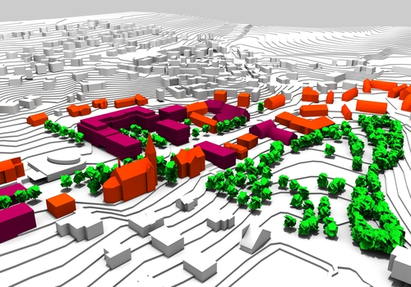
Territorial Approaches in 2014-2020:
An IQ-Net perspective
European Policies Research Centre,
University of Strathclyde, Glasgow
Notes:
New

Slide 2
Structure
IQ-Net – What is it?
Territorial approaches in 2014-20: An IQ-Net perspective
  Background
  Programming experiences
  Conclusions

Slide 3



Improving the Quality of Structural Funds Programme Management through Exchange of Experience

Slide 4
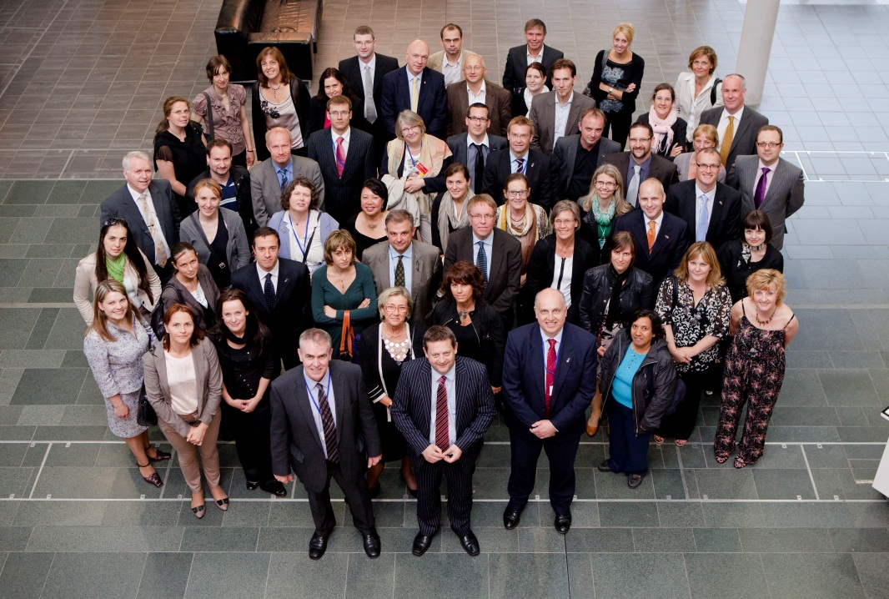
What is IQ-Net?
One of the longest-running knowledge-exchange networks on Structural Funds in the EU, set up in 1996
IQ-Net is a network which:
brings together Structural Funds managing authorities and implementing bodies from across the EU
applied research and debate - briefing papers are prepared by EPRC, bringing together comparative experience from
across the EU
exchange experience and
share good practice

Slide 5
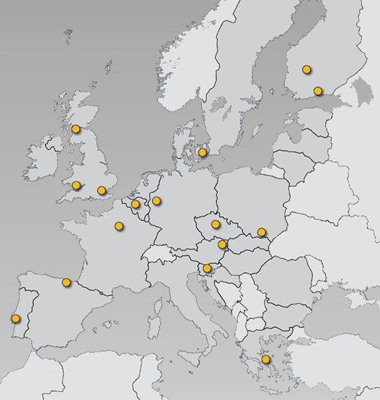
IQ-Net partners – regional/national programme authorities
Austria
Austrian Conference on
Spatial Planning (ÖROK)
Greece
Ministry of Development &
Competitiveness
Belgium
Vlaanderen
Czech Republic
Min. for Regional Development
Portugal
Agency for Development
and Cohesion
Denmark
Danish Business Authority
Slovenia
• Govt. Office for Development
and EU Cohesion Policy
Finland
South and West Finland
Spain
País Vasco (Bizkaia)
France
CGET (ex-DATAR)
United Kingdom
Dept for Communities &
Local Government (DCLG)
Wales (WEFO)
Scottish Government
Germany
Nordrhein-Westfalen

Slide 6
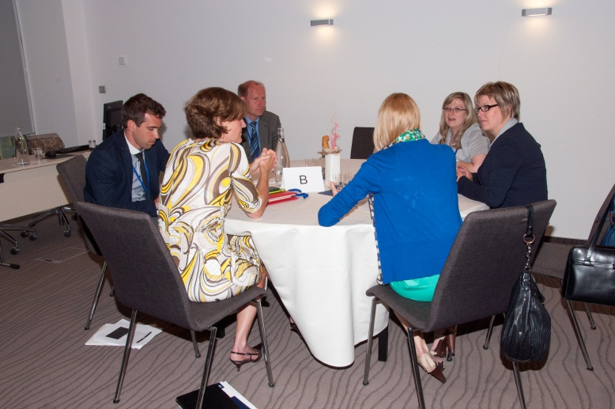

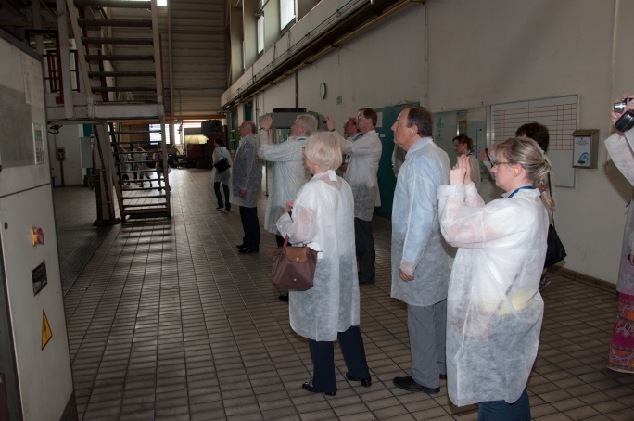
How does IQ-Net operate?
IQ-Net Conferences are held twice a year for partners to exchange experience on selected themes
Recent meetings in Scotland (UK), Laško (SI), Lower Austria (AT), Tampere (FI), Aachen (DE), Wales (UK) and Prague (CZ)
Conferences involve plenaries, small group discussion and project visits
DG Regio and DG Emploi are active participants

Slide 7
Territorial approaches in
Cohesion policy 2014-20:
An IQ-Net perspective

Slide 8
Context for the territorial dimension
‘Territorial’ Cohesion in the EU Treaty (TFEU, 2009)
Territorial and integrated approaches are superior to spatially blind interventions (Barca 2009)
Major challenges like globalisation, climate change, energy diverse social and demographic challenges have strong spatial dimension (Territorial Agenda 2011)
The EU Urban Agenda and urban dimension of EU policies (EC 2014)

Slide 9
A new framework for territorial instruments in 2014-20
Separate
Programme
Integrated Sustainable Urban Development
Minimum 5%
Delegated governance encouraged
Mainstream implementation approaches
Separate
Priority
Axis
Broader territorial scope
Urban
Rural-Urban
Sub-regional
Rural
Specific geographical features
Cross border
ITI
New
implementation approaches
CLLD
Notes:
The concept of territory and territorial approaches is slightly blurred.
ISUD requirements can be implemented through ‘mainstream approaches’: a separete programme or priority axis.
There are also or two new territorial appraoches.
ITIs can be used to implement ISUD and CLLD can contribute to it (as part of an investment priority).
However ITIs can also be used outside the ISUD requirements.

Slide 10
Comparing ITI and CLLD
ITI
CLLD
-Large urban areas
- One ITI per city
Geography
- Neighbourhood
- Many per city
- More top-down
- Voluntary
Approach
- Bottom-up
- Compulsory for EAFRD
- Sizable funding envelope
- ERDF and ESF
- Several priorities
Funding
- Smaller funding envelope
- EAFRD and EMFF
- Single priority (TO9)
MS decides criteria
Territorial strategy
Varied selection
Development
- MS define strategy criteria
- Requires CLLD strategy
MA setup selections com.
- Implementation MA or IB
- Urban strategies expected
to be implemented locally
Governance
- Local action groups
- Monitoring by MA
- Public sector led
Decision-making and
Monitoring
Pluralistic decision-making
LAG appraise projects

Slide 11
Tools for territorial approaches:
State-of-play at EU level
Integrated Sustainable Urban Development (ISUD)
€20 billion earmarked for ISUD at EU level
€9 billion through ITIs (21 Member States)
€10 billion though specific priority axes
€1 billion through dedicated OPs
Community-led Local Development (CLLD)
16 Member States intend to use ERDF + ESF, i.e. going beyond the requirement to implement them with EAFRD

Slide 12
Tools for territorial approaches:
Some IQ-Net examples
 | Priority Axes for ISUD | ITI for ISUD | ITI for other territories | CLLD with ERDF/ESF
Austria | X | - | - | X
Czech Republic | - | X | - | X
Denmark | X | - | - | -
England | - | - | X | X
France | X | X | X | -
Finland | - | X | - | -
Greece | - | X | X | X
Nordrhein-Westfalen | X | - | - | -
Pais Vasco | - | - | X | -
Portugal | X | X | X | X
Slovenia | - | X |  | X
Vlaanderen | X | - | X | -
Based on Draft OPs subject to change

Slide 13
Integrated Sustainable
Urban Development
Around 5% ERDF funding
(most)
Mono-fund
(most)
No intermediate body
(most)
Metropolitan
(some)
Two Thematic Priorities
(most)
Between 5-20% ERDF Funding
(some)
Multi-fund
(some)
Intermediate body
(some)
‘All’ urban centres
(some)
More than two Thematic Priorities (some)

Slide 14
Reasons not to use ITI
Inflexible because funding is tied up for a whole programming period or because of lack of alignment with other development strategies
Increases administrative burden
Limited ESI funds availability
Does not achieve real integration of ESI funds
Challenges in relation to pre-selection of ITI both in terms of quantity and timing

Slide 15



Key findings:
Integrated Territorial Investments (ITI)
Thematic focus
  Based on existing strategies but adapted to link to thematic objectives
  Targeting structurally weaker regions
Selecting ITIs
  Criteria for selection often set centrally (top-down), in some cases bottom-up, in others competitive calls
  Political conflict in some cases (city rivalry, copying)
Governance
  Local bodies significantly involved in implementation
  But limited use of intermediate bodies

Slide 16
Key findings: Community-led Local Development (CLLD)
Usually a continuation of the LEADER approach
Counterbalances the urban focussed ITI
But some countries use CLLD in a large number of areas, including peri-urban and urban areas
Increased EU co-financing rate of 10% (Art.120.6)
CLLD is often being programmed across multiple OPs contributing to multiple goals
Most will adopt the Managing Authority-led approach to CLLD rather than Intermediate Body-led approach

Slide 17
Reasons not to use CLLD for ERDF and ESF
Insufficient added value – already have extensive consultation with community-led actors or use similar approaches in domestic policies
Unsuitable community context – lack of community/participative culture
Lack of strategic alignment – scale and strategic orientation not suitable for ERDF focus on smart growth, competitiveness, R&D and innovation

Slide 18

Negotiation issues
Timing
Late approval of Regulations impacted on planning
Emerging Commission interpretation
No. of thematic Objectives
Second objective added without public consultation
More TOs weakens strategic focus
Multi-fund
Integrating ERDF and ESF is politically challenging
Territorial scope
Lack of urban character, insufficient concentration/critical mass, strategic (in)coherence of multi-city strategies
Added value
Development challenges were not considered specific
Uncertainties over legal status of IBs
Delegation
Pressure to delegate to Intermediate Bodies, but LAs do not always want implementation responsibility

Slide 19
Concluding points
Territorial tools are useful, flexible and innovative but enthusiasm is not always shared
Pressure on MAs to support integration from EU and from local actors (often ‘rent-seeking’)
Not easy to establish new structures and implementation mechanisms
Resistance to delegation of responsibilities to lower level government, partly because of capacity constraints
Tension between territorial approaches and result orientation
Need more guidance, scenarios, good practice examples, especially for ITI

Slide 20
Thank you for your attention
For more information:
www.eprc.strath.ac.uk/iqnet/
20

