Slide 1
Communicating EU Regional policy in Spain 2014-2020
Ana-Paula Laissy
Head of the Communication Unit
European Commission
Directorate-General Regional and Urban Policy
San Lorenzo de El Escorial (Madrid), 12 -13 Dec. 2013

Slide 2
Structure of the presentation
Key changes to the communication rules
Eurobarometer results about EU Regional policy in Spain
Who? Key actors
What? Key activities
Where? Communication rules in the Common Provisions Regulation Art. 105-107; Annex VI (applies to ERDF, ESF and CF)

Slide 3
Key changes compared to 2007-2013
A single cohesion policy website or portal has to be set up. Including the other ESI Funds (EAFRD, EMFF) would be a good practice (e.g. in Bulgaria).
The online list of operations has to be updated twice a year (instead of yearly) and be more user-friendly (no more PDF files).
Information and Communication officer, at national level, (current INFORM member) responsible for portal and co-ordination of communication network.
Posters (A3) for all projects below €500,000 of public co-funding (EU+national).
Most rules regarding communication are part of the CPR, but detailed rules on the use of the EU emblem and templates for billboards, plaques etc, will be covered by an Implementing Act (Jan. 2014).
Notes:
Continuous publicity (campaigns, AV material, competitions, exhibitions, billboards, posters, media relations, etc.)

Slide 4
Key changes compared to 2007-2013
The 7-year Communication plan is now called the communication strategy (6 months after OP adoption)
There may be one communication strategy for several operational programmes and one Monitoring Committee may be designated to approve it, but all relevant Monitoring Committees have to be consulted
The Commission no longer approves the communication strategy or subsequent amendments. In return, the managing authority and the Monitoring Committee have to take ownership of communication issues and review progress systematically in the Monitoring Committee (MC) meetings -> yearly reporting by MA to the MC. Communication chapter included in Annual Implementation reports of 2017 and 2019 only.
Notes:
Continuous publicity (campaigns, AV material, competitions, exhibitions, billboards, posters, media relations, etc.)

Slide 5
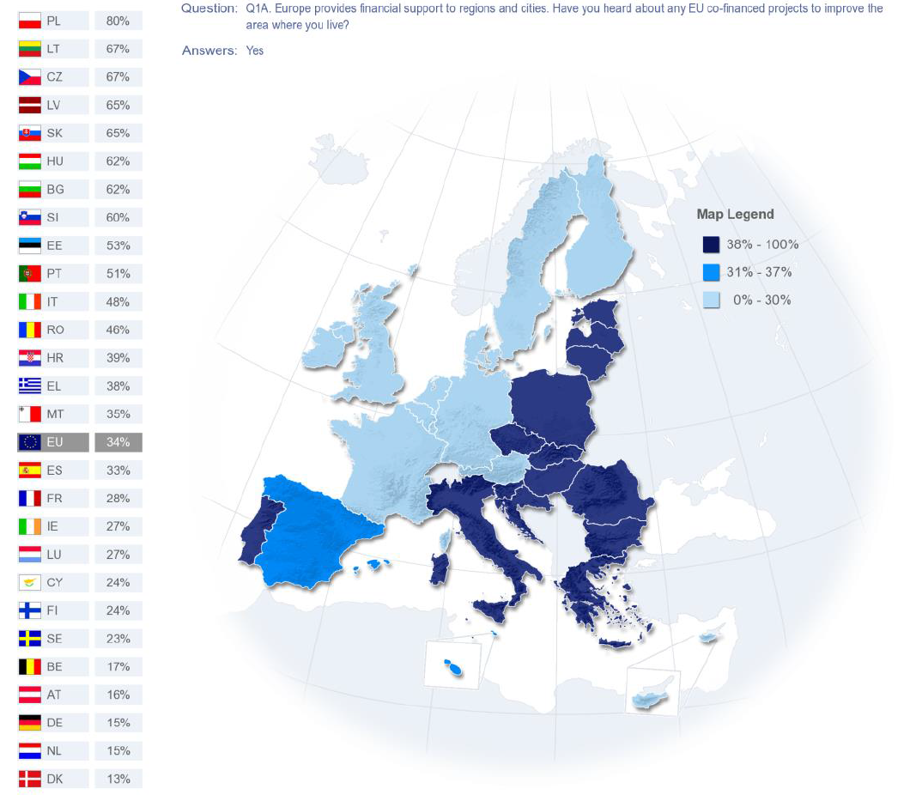

Slide 6
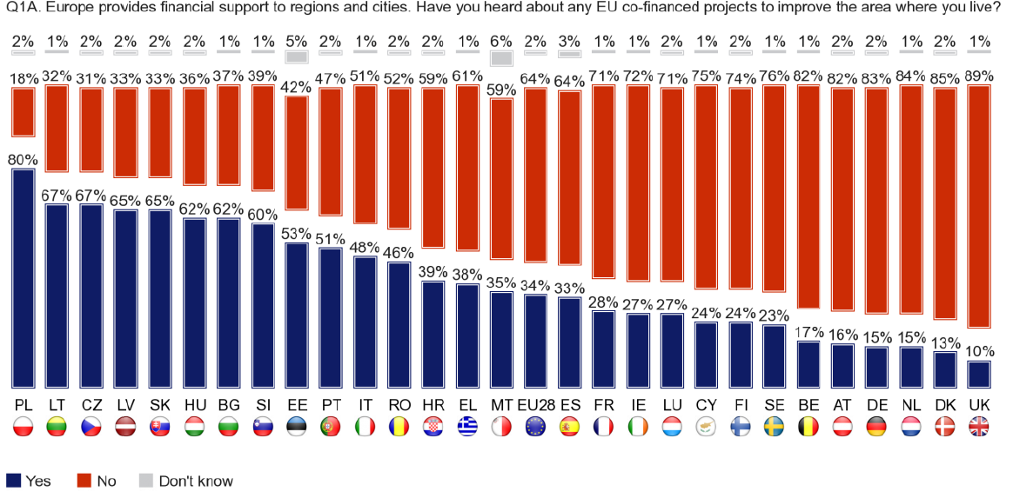

Slide 7
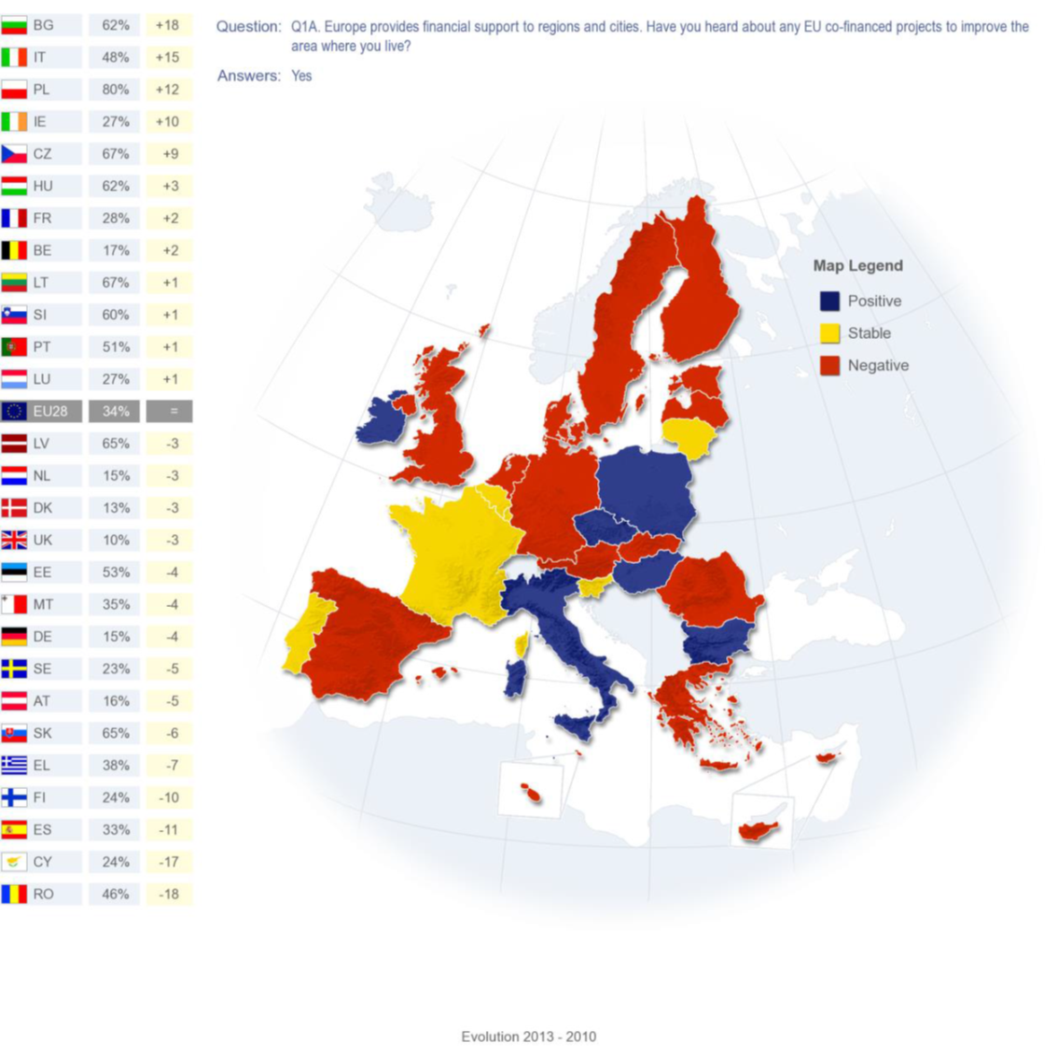
Trend
2010-2013
Notes:
Continuous publicity (campaigns, AV material, competitions, exhibitions, billboards, posters, media relations, etc.)

Slide 8
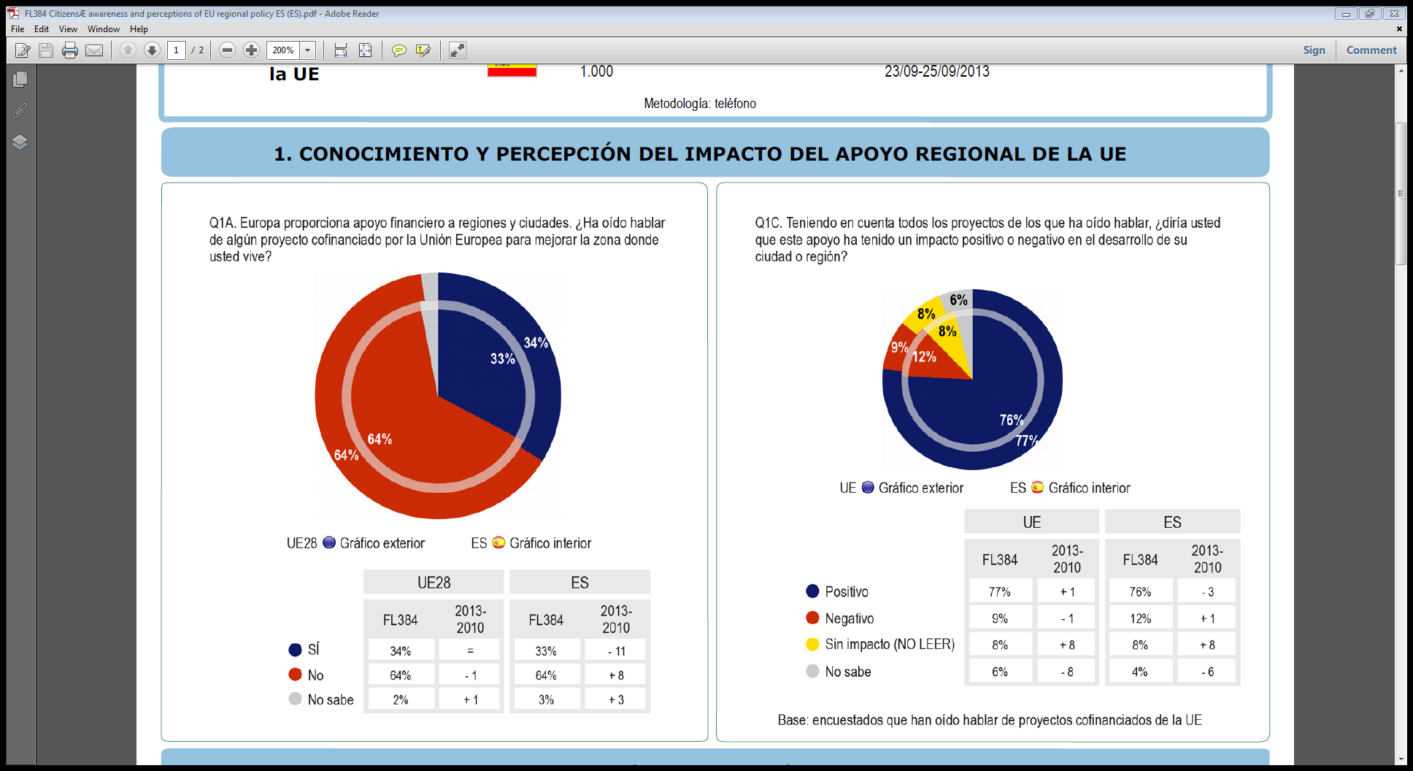

Slide 9
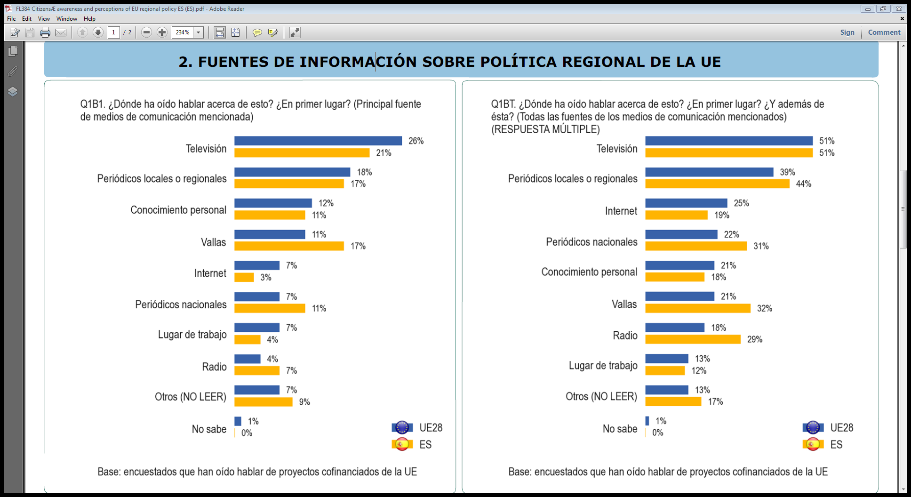

Slide 10
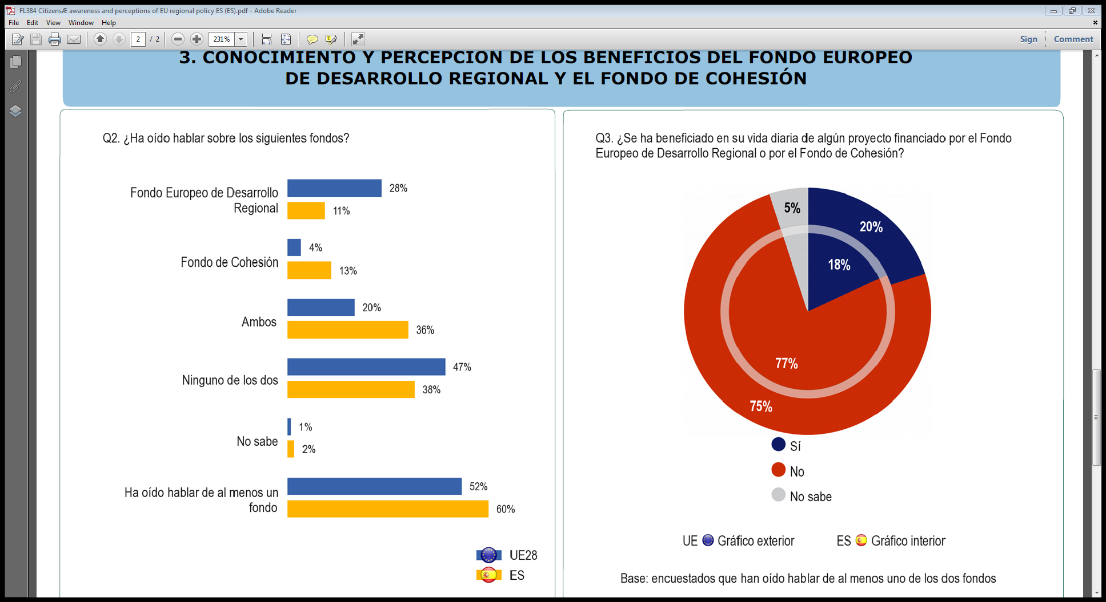

Slide 11
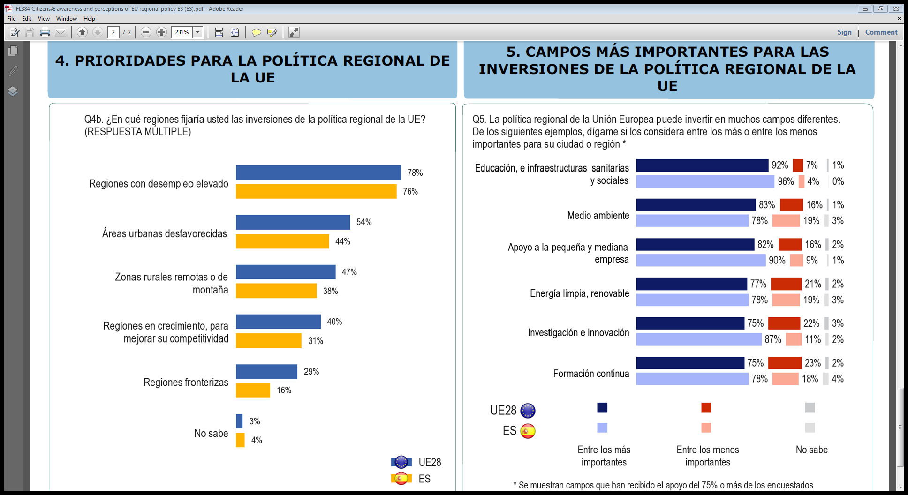

Slide 12
Key actors
Member State: Information & Communication Officer
Managing Authority: Communication officer
Beneficiaries
European Commission (incl. Commission Representations in Member States)

Slide 13

Key activities – Communication strategy for each Operational programme

Slide 14
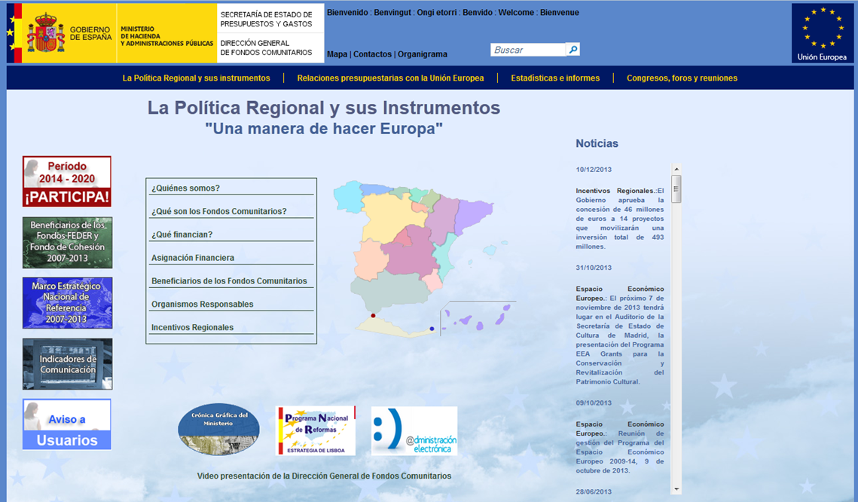
Key activities - Cohesion policy portal
(incl. ETC programmes)

Slide 15
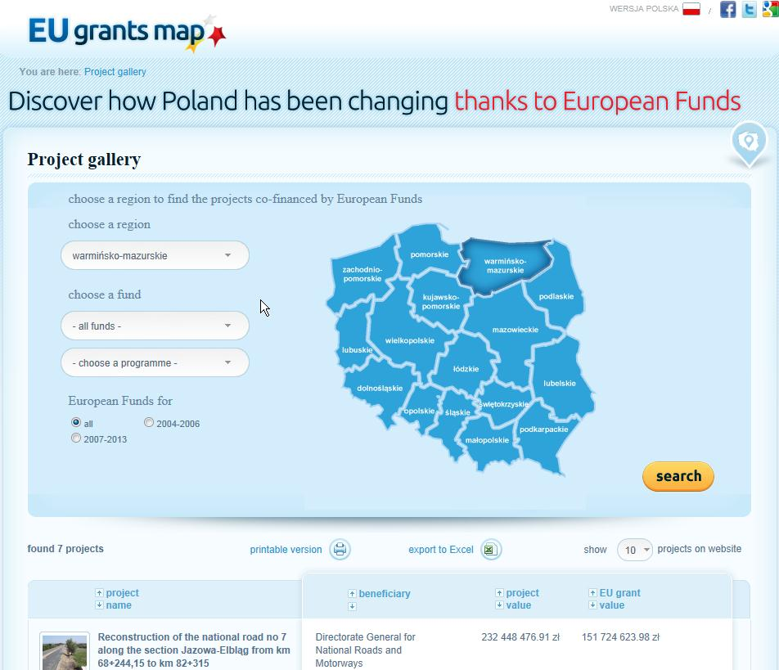
Key activities - Cohesion policy portal with project examples

Slide 16
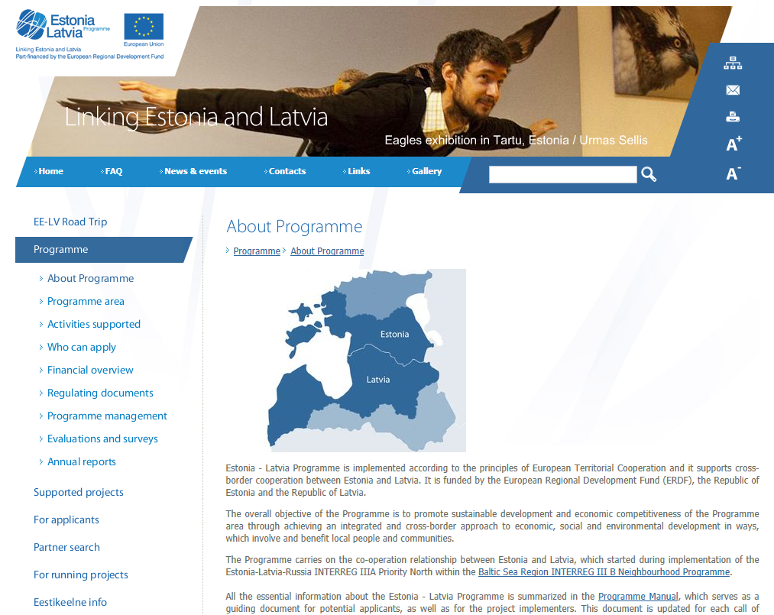
Key activities – Operational programme website

Slide 17
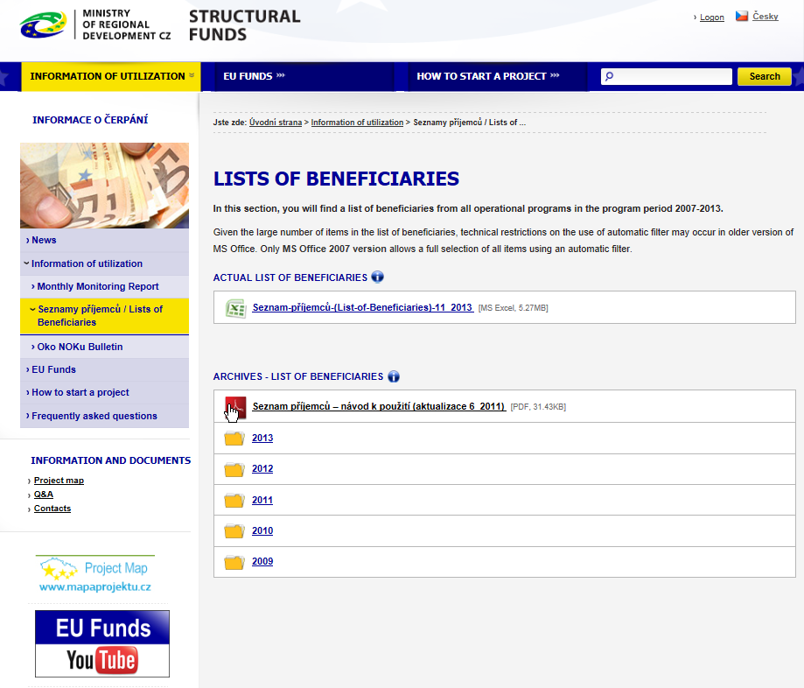
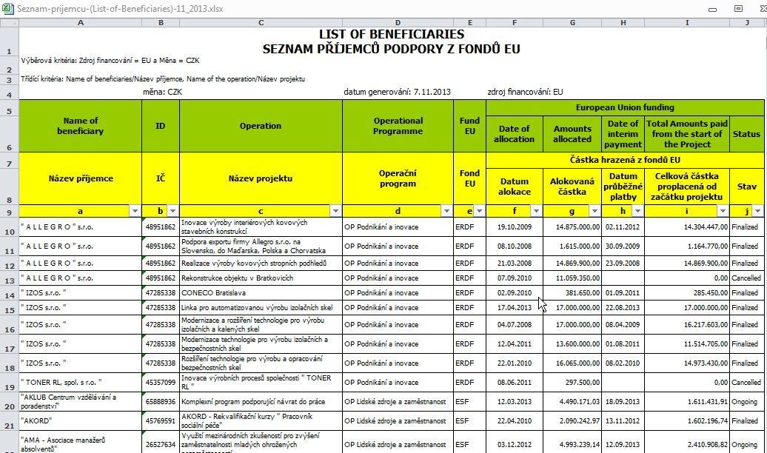
Key activities - List of Operations

Slide 18
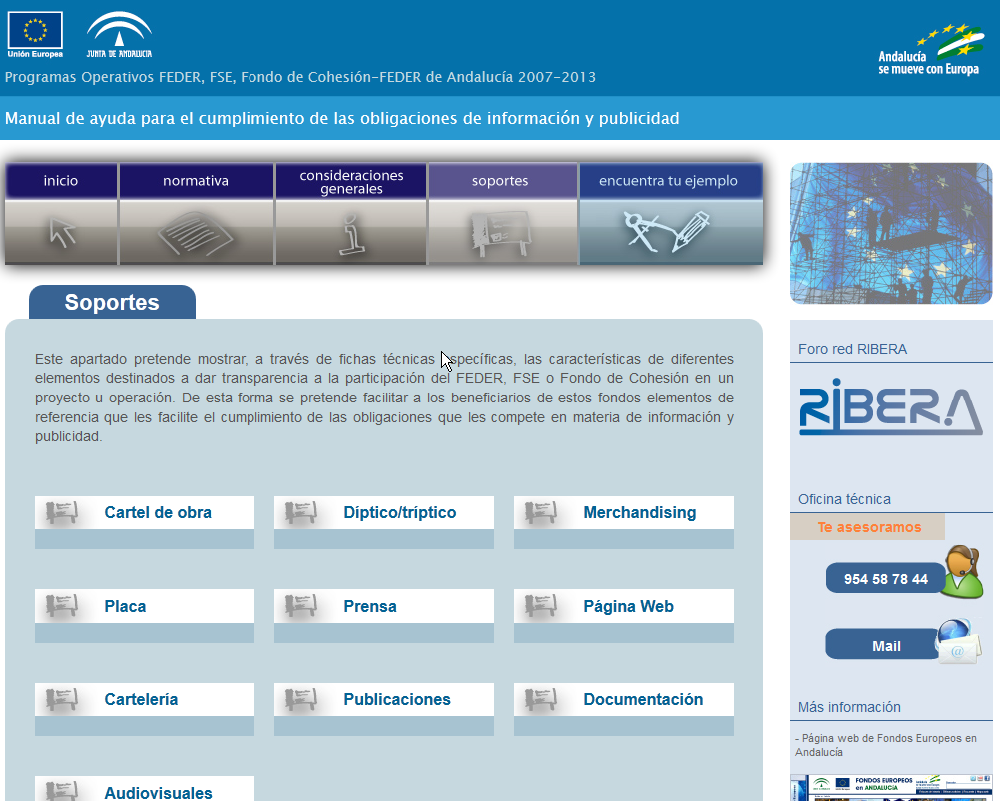
Key activities – Help beneficiaries meet their publicity requirements

Slide 19



Key activities – OP launch event /
Major Annual Information Activity

Slide 20
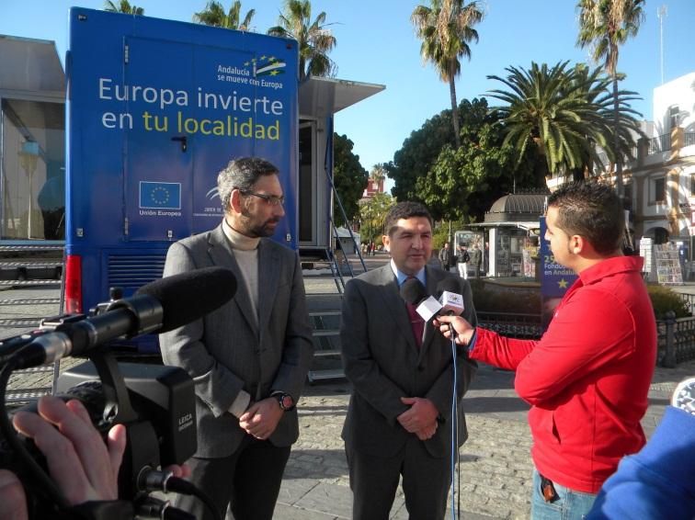
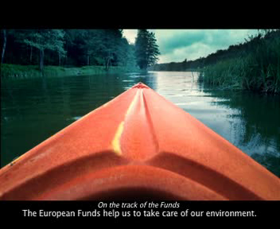
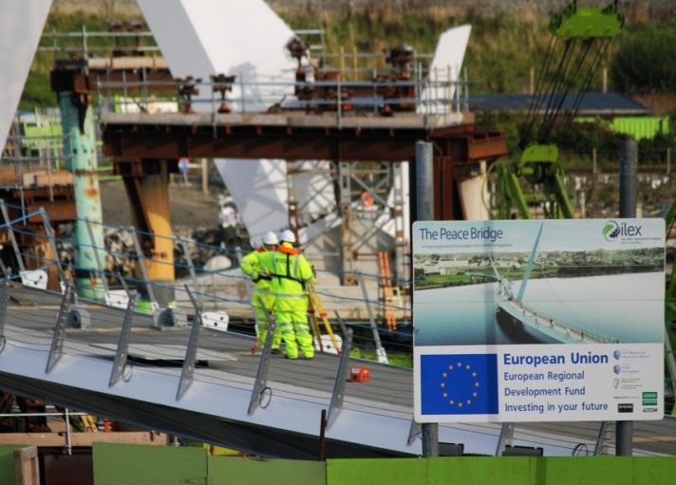
Key activities – continuous publicity by Managing Authority & beneficiaries

Slide 21
Communication is the job of all ESI Funds stakeholders
Thank you for your attention!
Notes:
Continuous publicity (campaigns, AV material, competitions, exhibitions, billboards, posters, media relations, etc.)

