Slide 1
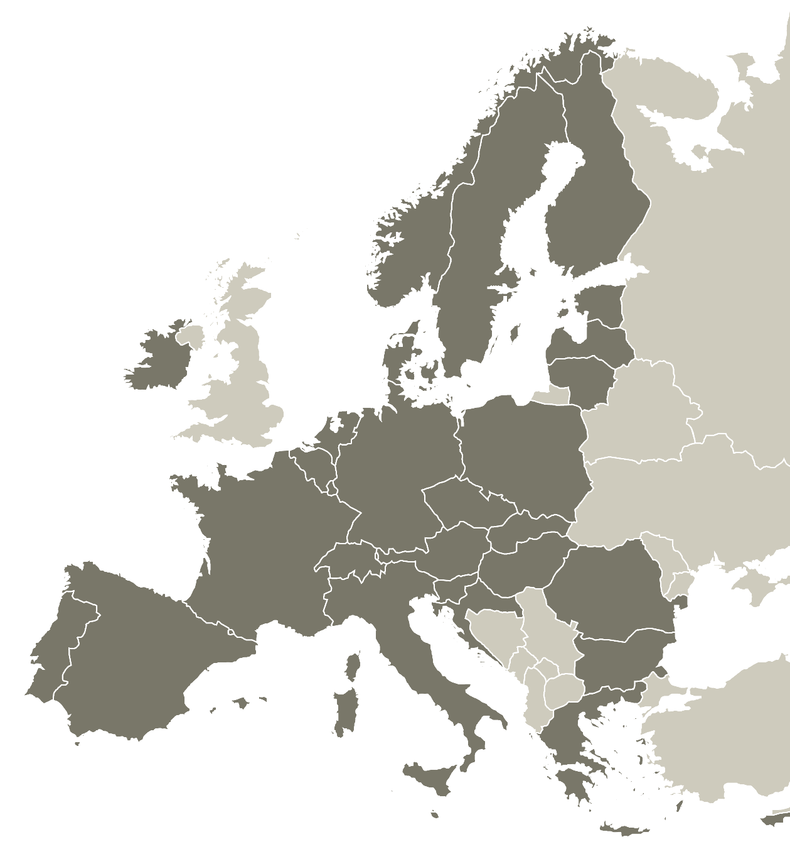


Key project
features
Charo Camacho
Senior Policy Officer | Interreg Europe Secretariat
24 March 2022
Spanish Information Day
Online

Slide 2

Disclaimer
Information in the presentation is subject to the programme approval by the European Commission and validation by the future Interreg Europe monitoring committee.

Slide 3
Content
Project objectives & activities
Partnership requirements
Project finances

Slide 4
1.
Project
objectives & activities

Slide 5

Project objective
Improve the policy instruments of the participating regions
  Public interventions at local, regional or even national levels can be addressed
  But at least one policy instrument per project must be an
  Investment for jobs and growth goal programme

Slide 6
Project activities
Exchange of experience & capacity building through identification and transfer of good practices
Pilot actions possible from the start of the project or at mid-term (but maximum one per policy instrument)

Slide 7
What is a good practice
?
A policy-related initiative
Proved to be successful in a region
Potential source of inspiration for other regions

Slide 8


Example of a good practice
Methodology for safe routes to schools.
This good practice (Municipality of Girona) is about encouraging the use of active transport (cycling, walking) by children and their parents as a good way of setting life-long behaviour. To be successful, parents need to be sure that their children will be safe and need to be encouraged also to change their own behaviour. This methodology for determining safe routes to schools – bring together stakeholders (parents, schools, municipalities); evaluate current behaviour and determine which routes are mostly used and plan interventions to improve safety.

Slide 9
What is a pilot action
?
Implementation-related activities dedicated to testing a new public intervention approach.
Possible only under certain conditions:
  Clear contribution to policy improvements
  Clear interregional & testing character

Slide 10


Example of a pilot action
Development of an energy and educational community (EEC) in a vulnerable area (Andalusian Energy Agency, Regional Government of Andalusia).
This pilot action is based on experiences from the French partner (AURAEE). It aims at improving the Energy Strategy for Andalusia 2030 by enabling vulnerable groups affected by energy poverty to have access to RE, save on their electricity bills, and thus alleviate energy poverty. At the same time, it promotes a new energy culture by integrating the educational dimension into the concept of energy community, which contributes to a more ‘decarbonised’ society. Through this action, vulnerable people become relevant actors in the energy transition.
The pilot action tests the development of a small energy and educational community (EEC) in the neighbourhood of Torreblanca (Seville) classified as a vulnerable area in Andalusia (Spain). It approaches the community from its legal, social and technical dimensions.
In case of success, AEA will integrate a specific line “Incentives program aimed at local energy communities and business models” in the policy instrument addressed. This guarantees the technical and economic viability of these EEC as a tool to overcome energy poverty.

Slide 11
Implementation of activities
2 phases over 4-year implementation
CORE | FOLLOW UP
3 years | 1 year
Exchange of experience to achieve policy improvements | Monitor policy improvements

Slide 12
Implementation of activities
Action plans only for regions which did not achieve results by end of core phase​
Some flexibility in the follow-up phase:
  Up to each project to define the exact activities
  Exchange of experience still possible

Slide 13
2.
Partnership
requirements

Slide 14

Who is eligible?
Public authorities
Public law bodies (bodies governed by public law)
Private non-profit bodies

Slide 15
Policy relevance of partnership
Policy responsible authorities must be involved in the project:
As partners for at least 50% of the policy instruments addressed
As ‘associated policy​ authorities’ for the remaining policy instruments
Creation of a stakeholder group in each region

Slide 16
What is an associated policy​ authority
?
Main features:
Officially included in the application form
No budget - travel & accommodation costs covered by relevant project partner
Declaration provided at the application stage
Involvement regularly monitored during project implementation

Slide 17

Geographical coverage
Broad coverage required
Mixed between more and less advanced regions

Slide 18
3.
Project
finances

Slide 19
Co-financing rates
Co-financing rates | According to legal status or location
80% ERDF* | Public or public equivalent from the EU
70% ERDF* | Private non-profit from the EU
50% Norwegian funding | Public, public equivalent and private non-profit from Norway (NO)
Swiss funding | Public, public equivalent and private non-profit from Switzerland (CH)
* ERDF – European Regional Development Fund

Slide 20
Simplified financial rules
Cost categories | Simplification
Preparation costs | Lump sum €17,500
Staff | Fixed % of the real gross employment cost
Office & administration | Flat rate of 15% of staff costs
Travel & accommodation | Flat rate of 15% of staff costs (real cost reporting only in specific justified cases)
External Expertise and Services
Equipment
Infrastructure and Works | For pilots only
Plus:
Simplified reporting, faster payments to projects
Less control (sampling, risk-based verifications)

Slide 21
?
Time for questions

Slide 22
First call
features
Czech Information Day
Online

Slide 23
Call main features
When? 5 April – 31 May 2022, 12 noon (CEST Paris time)
How much? Up to 130 MEUR
About what? all topics open
From where? all corners of the programme area

Slide 24
Timing of the call
8 weeks
Opening: 5 April 2022 (portal available)
Closing: 31 May 2022 at 12:00 CEST (Paris time)
Decision: end of 2022
Draft application pack available from February

Slide 25


Budget for the first call
+ Norwegian funding
MEUR
334
ERDF*
MEUR
130
ERDF*
Up to 40% for the first call
TOTAL BUDGET
* ERDF – European Regional Development Fund

Slide 26



Topics of the call
All topics open
Concentration principle (80%)

Slide 27

Insight into topics
Within 80%
Research and Innovation capacities, uptake of advanced technologies
Digitisation for citizens, companies, research organisations and public authorities
Sustainable growth and competitiveness of SMEs and job creation in SMEs, including by productive investments
Skills for smart specialisation, industrial transition & entrepreneurship
Digital connectivity

Slide 28

Insight into topics
Within 80%
Energy efficiency and reduction of greenhouse emissions
Renewable energy
Smart energy systems, grids and storage
Climate change adaptation, disaster risk prevention, resilience
Access to water and sustainable water management
Circular and resource efficient economy
Protection and preservation of nature and biodiversity, green infrastructures, pollution reduction
Sustainable urban mobility for zero carbon economy

Slide 29

Insight into topics
Within 80%
Effectiveness and inclusiveness of labour market, access to quality employment, social economy
Equal access to health care, health systems resilience, family-based and community-based care
Culture and tourism for economic development, social inclusion and social innovation

Slide 30


Insight into topics
Accesses to education, training and lifelong learning, distance and on-line education and training
Inclusion of marginalised communities, low-income households and disadvantaged groups
Socio-economic integration of third country nationals, including migrants
Climate resilient, intelligent, secure, sustainable and intermodal TEN-T
Sustainable, climate resilient, intelligent and intermodal national, regional and local mobility
Sustainable integrated territorial development, culture, natural heritage, sustainable tourism and security

Slide 31

Insight into topics
‘Non-thematic’ topics related to implementation of regional development policies
For example:
evaluating and monitoring public intervention
management of public procurement
management of state aid
management of financial instruments

Slide 32
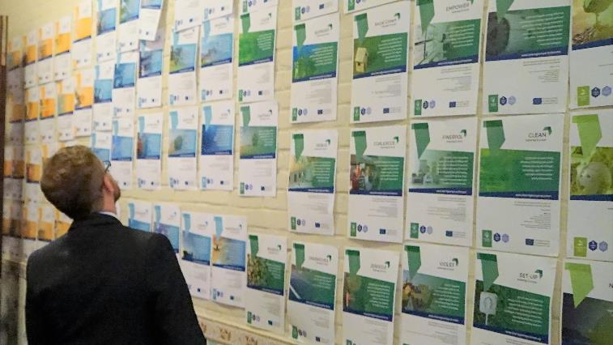
Innovative character
What is the added value of your project?
Remember to check:
www.interregeurope.eu/approved-projects

Slide 33
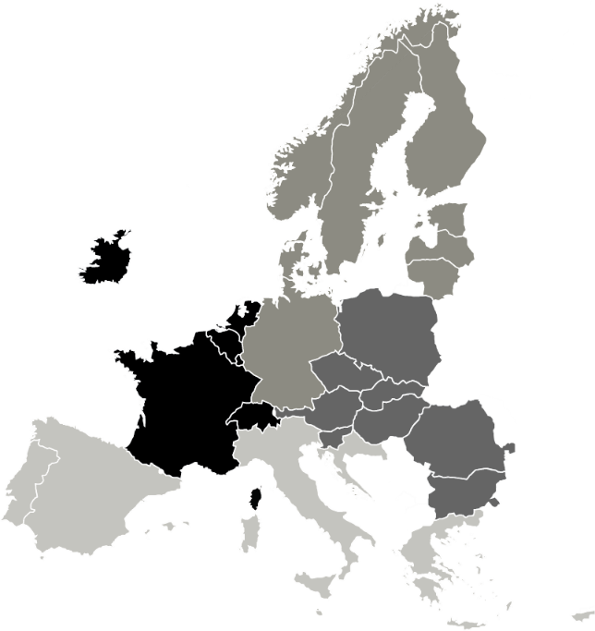

Geographical coverage
Four areas to be covered
Geographical areas | Countries covered
North | Denmark, Estonia, Finland, Germany, Latvia, Lithuania, Norway, Sweden
East | Austria, Bulgaria, Czech Republic, Hungary, Poland, Romania, Slovakia, Slovenia
South | Croatia, Cyprus, Greece, Italy, Malta, Portugal, Spain
West | Belgium, France, Ireland, Luxembourg, Netherlands, Switzerland
Notes:
* For NIDs in France, Spain and Portugal, please mention the exception to this rule for RUPs

Slide 34
?
Time for questions

Slide 35
Thank you!

