Slide 1



Assistance
to applicants
María Teresa Tello
Subdirección General de Cooperación Territorial Europea
Dirección General de Fondos Europeos
Ministerio de Hacienda y Función Pública
Charo Camacho
Senior Policy Officer
Interreg Europe Secretariat
24 March 2022
Spanish Information Day
Online

Slide 2
Content
Tools for project development
Other assistance tools
Point of contact assistance

Slide 3
1.
Tools for
project
development

Slide 4
Steps to project development
Check relevance
Get inspired
Share project idea
Find partners
Ask for feedback

Slide 5
Check relevance
Is Interreg Europe for you?
Are you involved in regional development policies?
Are you looking for new solutions?
Are you ready to work with partners from other European countries?
https://www.interregeurope.eu/your-projects-relevance ​

Slide 6
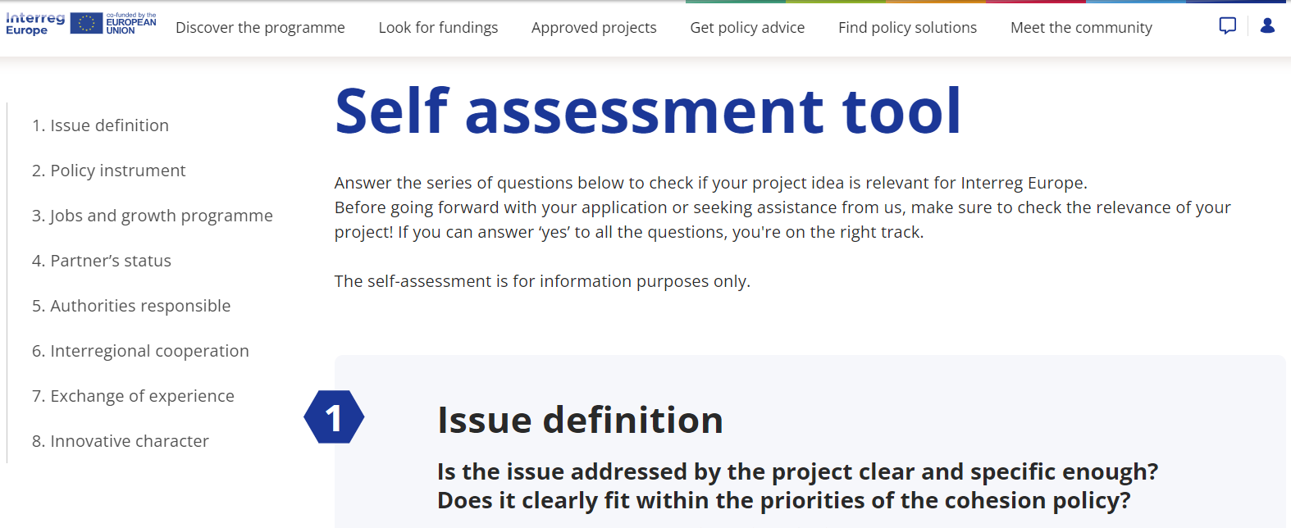
Check relevance
Self-assess your idea before asking for our feedback
https://www.interregeurope.eu/your-projects-relevance ​

Slide 7
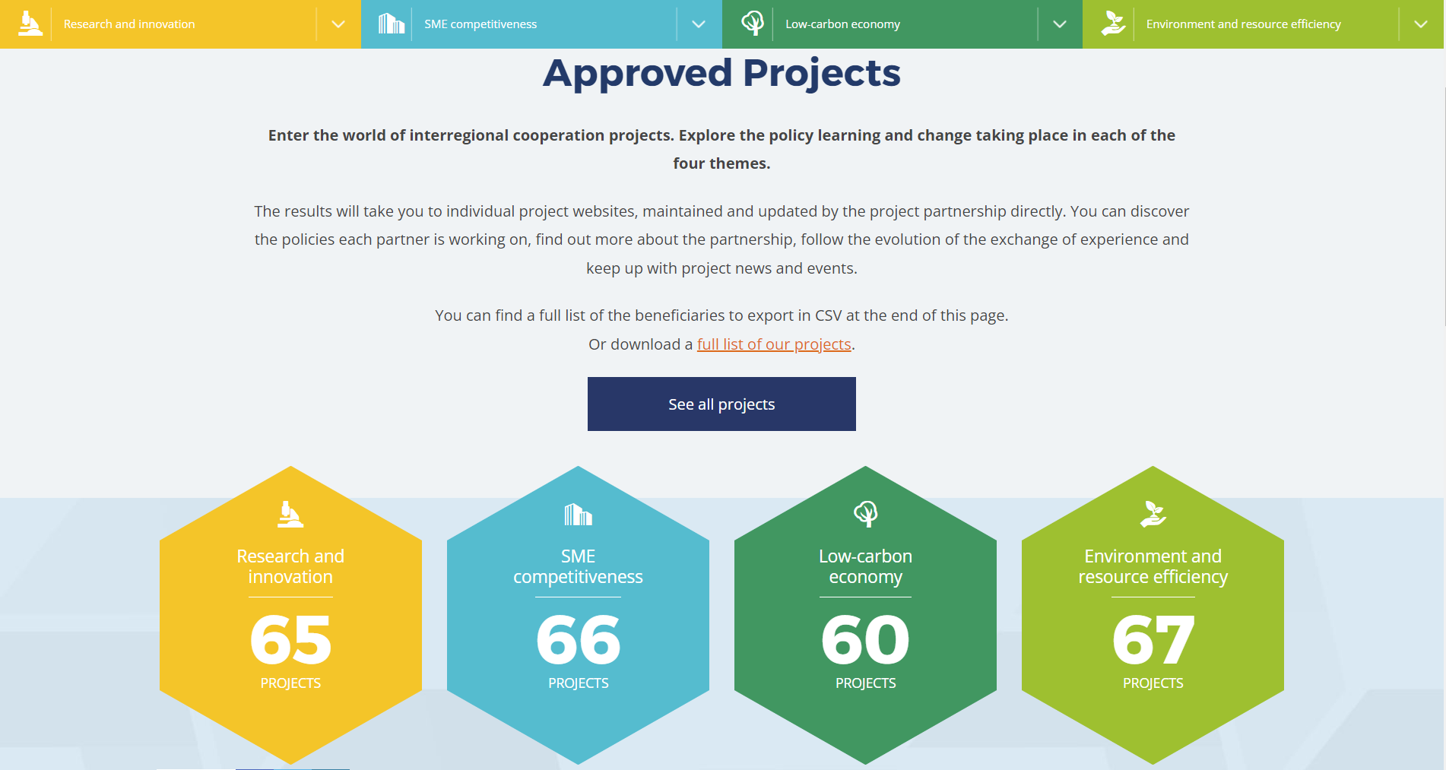
Get inspired by running projects
Check what kind of activities our programme supports
www.interregeurope.eu/search-approved-projects

Slide 8

Get inspired by other project ideas
Check what project ideas already exist and search for partners
https://www.interregeurope.eu/en/project-ideas

Slide 9

Share project idea
Publish your project idea on our website to tell others:
what you’d like to do
what partners you are looking for

Slide 10
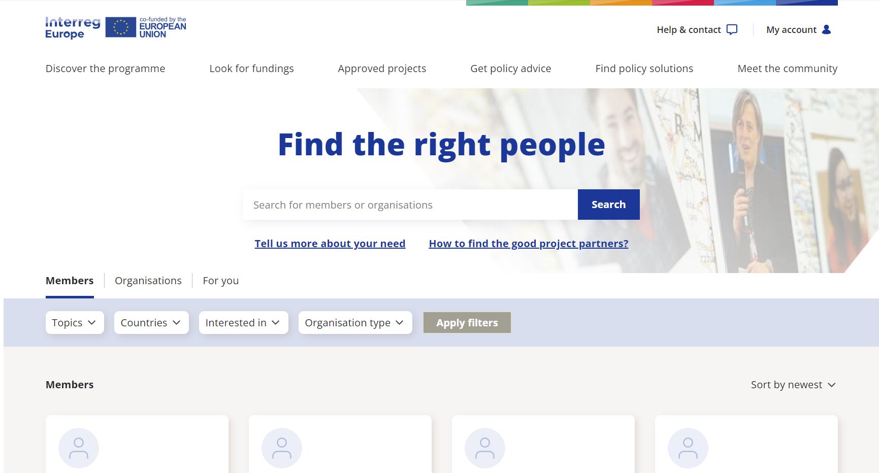
Find partners
Search for people or organisations to find project partners
www.interregeurope.eu/community/members

Slide 11
Ask for feedback from the joint secretariat
Once you develop all aspects of your project idea
ask for programme’s feedback
  One feedback per idea and call
Our policy and finance officers will give you feedback:
  In writing
  On the phone/ online

Slide 12
2.
Other
assistance
tools

Slide 13
Key documents
Programme manual
Terms of reference for the first call for project proposals

Slide 14
First call launch event #europecooperates
5 April 2022, 10:00 – 16:00
Online event presenting the features of the first call
Networking opportunities to complete project partnerships
Inspiration from running projects

Slide 15
Q&A online hours
Regular online sessions with policy and finance officers
Ready to answer all your questions about project development for the first call for proposals
During the call: from April
Usually on Fridays from 10:00 AM (Paris time)

Slide 16
Additional questions
FAQ section of the website
Contact us form

Slide 17
3.
Point of
contact
assistance

Slide 18
Point of contact assistance
General information on the programme and the call for projects
Infodays
Workshops for beneficiaries and first level controllers
Information on the Spanish Control System

Slide 19
Point of contact assistance
Ivana Orejuela Galiot iorejuela@sepg.hacienda.gob.es iorejuela@sepg.hacienda.gob.es
Mª Teresa Tello Naya mttello@sepg.hacienda.gob.es

Slide 20
?
Time for questions

Slide 21
Thank you!

