Slide 1
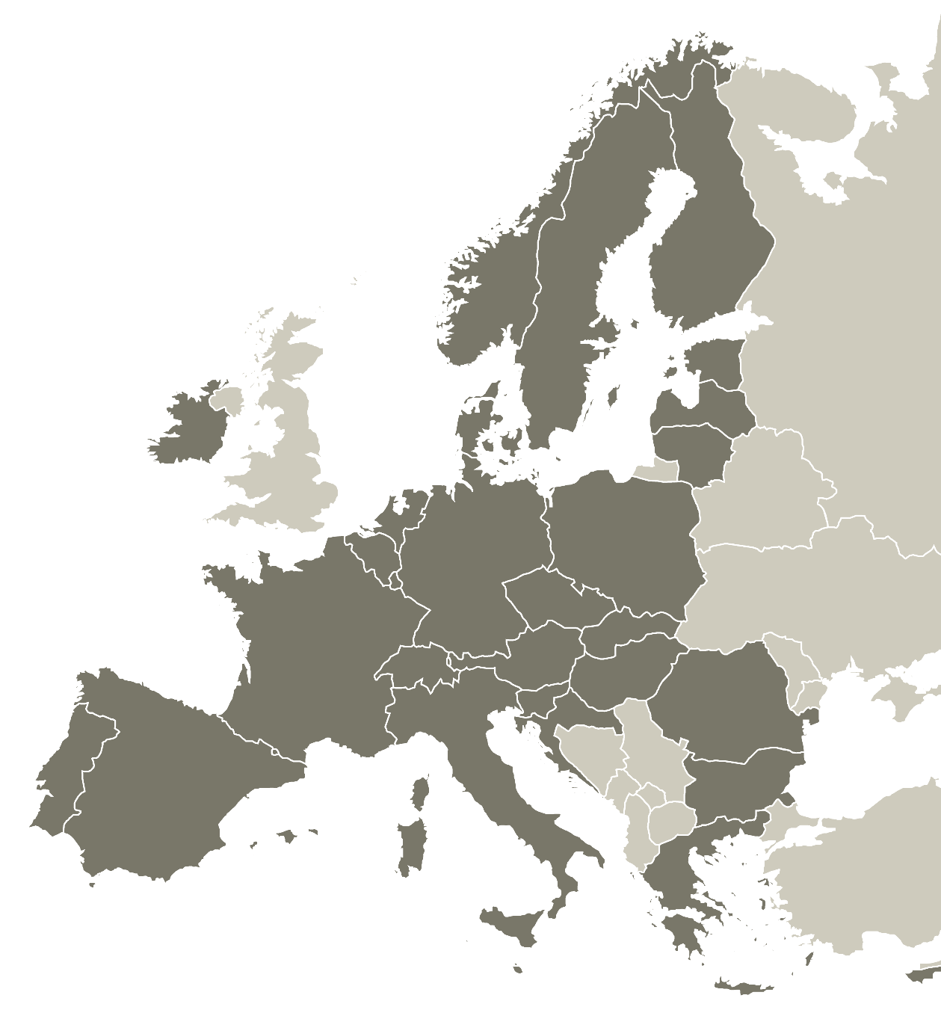
Key programme
features
María Teresa Tello
Subdirección General de Cooperación Territorial Europea
Dirección General de Fondos Europeos
Ministerio de Hacienda y Función Pública
24 March 2022
Spanish Information Day
Online

Slide 2
Disclaimer
Information in the presentation is subject to the programme approval by the European Commission and validation by the future Interreg Europe monitoring committee.

Slide 3
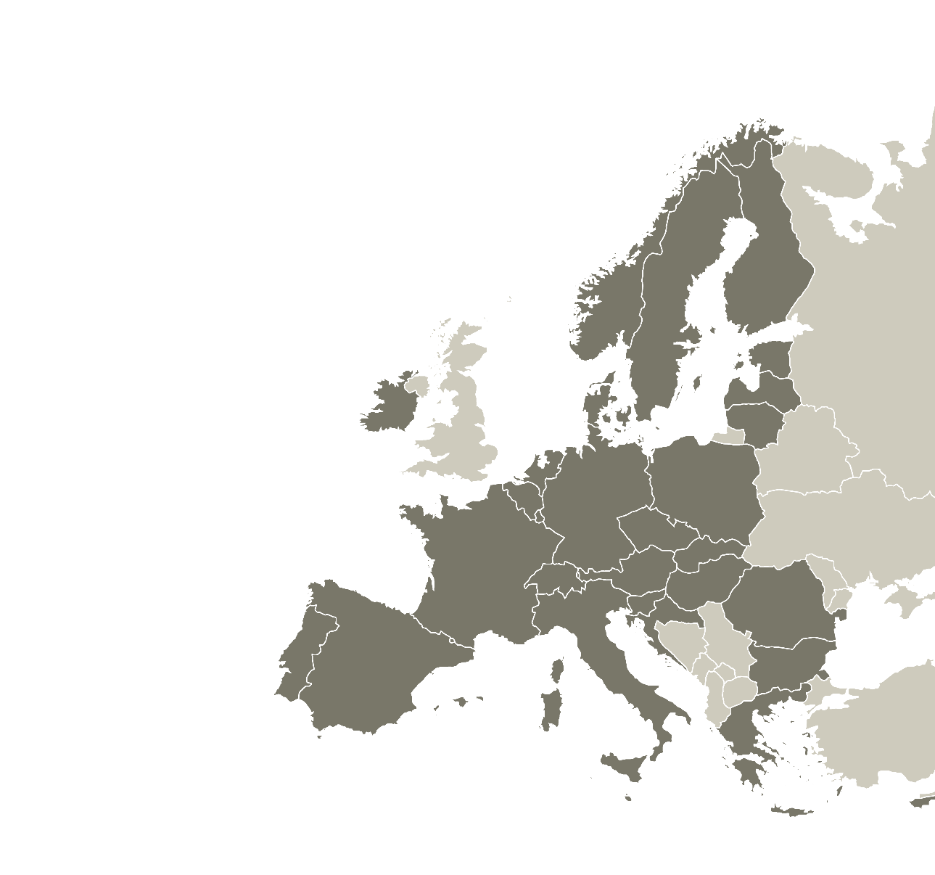
Sharing solutions for better regional policy
6
29
379m
PROGRAMME
BUDGET
TOPICS
COUNTRIES
INVOLVED

Slide 4
Interreg Europe objective
To improve regional development policy instruments (including Investment for jobs and growth goal programmes)​
How?
Through exchange of experience, innovative approaches and capacity building
Primarily dedicated to policymakers​
Focus on exchange of experience​
Different from cross-border or transnational cooperation​
Notes:
In a simple word: Interreg Europe helps policy makers to find new solutions to the challenges they face in their region.

Slide 5
What is a policy instrument
?
A means for public intervention:
a strategy, programme or law
developed by public authorities
applied to improve a specific territorial situation
Investment for jobs and growth goal programmes are policy instruments.

Slide 6
What is a ‘policy​ responsible authority’
?
The organisation in charge of the elaboration and/or delivery of a specific policy instrument
In most cases, a public institution
Notes:
not necessarily related to the legal status of the organisation

Slide 7
Example of a policy instrument
The Andalusian Strategy for Sustainable Development of Marine Aquaculture (EADSAM) is a policy instrument managed by the Regional Government of Andalusia.
It establishes the strategic lines for a sustainable and competitive development for the aquaculture, acting on the reinforcement of the innovation and technological development for the progress of the aquaculture activities.

Slide 8
What is a policy improvement
?
Our projects report three types of results:
New projects
Change in governance
Change in the policy instrument itself

Slide 9
Example of a policy improvement
PI Improved: The Andalusian Strategy for Sustainable Development of Marine Aquaculture (EADSAM)
As a result of the cooperation in the framework of the ENHANCE project, the partner (Regional Government of Andalusia) improved the governance of the EADSAM by adopting new managerial approaches. These new approaches addressed:
The coordination between the concerned Directorates-General (DGs).
The way environmental issues were integrated within the strategic lines of the EADSAM.
The integration of the EMAS Scheme in the planning and implementation of the policy instrument.
Inspiration from: Derived from the good practices shared by the Italian partner (Sant’Anna School of Advanced Studies) about how the public support to the integration of EMS (according to the EMAS Regulation) resulted successful to aquaculture companies in terms of costs saving, image improvement, economic incentives, reduction of frequency inspections and guarantee of Environmental legal compliance.

Slide 10
Programme scope
1 cross-cutting priority on capacity building six topics .
Concentration principle (80%)

Slide 11
Two actions
Projects
Limited number of regions exchanging and transferring experience on a shared regional development issue
Policy Learning Platform
Further exploiting projects’ achievements and opening up the programme benefits to all

Slide 12
Platform in a nutshell
Provides continuous policy-learning opportunities
through access to:
Knowledge
People
Expert support
#policylearning

Slide 13
Access to knowledge
Wealth of policy solutions available
Database of good practices from all EU
Analytical policy briefs, news and publications

Slide 14
Access to people
Policy inspiration from practitioner to practitioner
Community of 25,000+ practitioners
Networking and policy-learning events

Slide 15
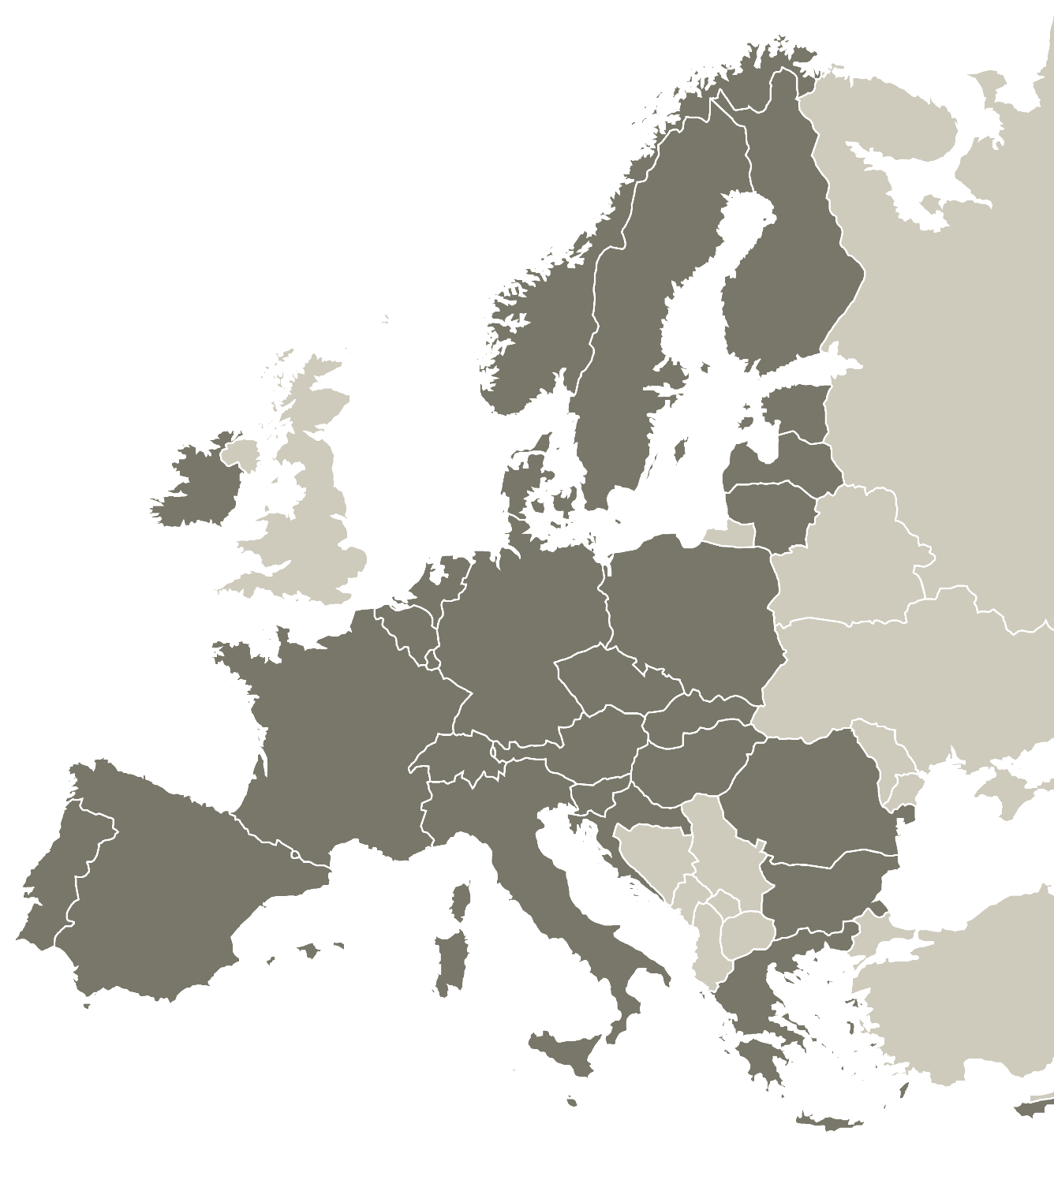
Access to expert support
Expert support services for free
Peer reviews
Matchmaking sessions
Policy help desk
Apply to benefit from expert support any time

Slide 16
?
Time for questions

Slide 17
Thank you!

