Slide 1



Info Day
From INTERREG IVC to INTERREG EUROPE

Slide 2


Agenda of the day
10:00 Welcome / From INTERREG IVC to INTERREG EUROPE
10:30 Zooming in on INTERREG EUROPE
11:30 Coffee – break
12:00 Zooming in on INTERREG EUROPE
13:00 Support for projects
13:30 Q&A panel
14:00 End of the day

Slide 3

INTERREG IVC
INTERREG IVC (2007-2013)
‘Learning by sharing’
Local / regional authorities exchange the experience
with others in Europe facing similar challenges
in order to improve their practices / policies
EU 27
Norway
Switzerland
Public authorities
Bodies governed by public law

Slide 4
INTERREG IVC
204
projects
2 285 partners
90% of 271 NUTS 2 regions covered
Innovation and the knowledge economy
Environment and risk prevention
Notes:
LOCARE: Priority 2, Energy and Sustainable transport
11 mini-programmes in total under IVC

Slide 5
INTERREG IVC
Main achievements (2015)
90% of EU NUTS 2 regions covered
7,968
staff with increased capacity
397
‘spin-off activities’
Objective:
EU wide exchange of experience / capacity building
Objective:
Identification / sharing / transfer of good practices
6,291
good practices identified
532
successfully transferred
Overall objective:
Improvement of regional and local policies
1,943
policies addressed
574
policies improved
See illustrations of results in the programme Annual Report!

Slide 6

Spain in INTERREG IVC
Main achievements in Spain (2015)
667
staff with increased capacity
35
‘spin-off activities’
Objective:
EU wide exchange of experience / capacity building
Objective:
transfer of good practices
34
successfully transferred
Overall objective:
Improvement of regional and local policies
25
policies improved

Slide 7
Spain in INTERREG IVC
1636 partners / 1003
project applications
247 ES-led applications
10.3 % approved (vs 15% prog ave)
21 LP
170 partners
153 projects
32 million € ERDF

Slide 8

INTERREG IVC
Thematic programme capitalisation
12 sets of reports, brochures & policy papers
All available at:
www.interreg4c.eu/capitalisation/
Notes:
All with specific good practice examples and tailored policy recommendations.

Slide 9
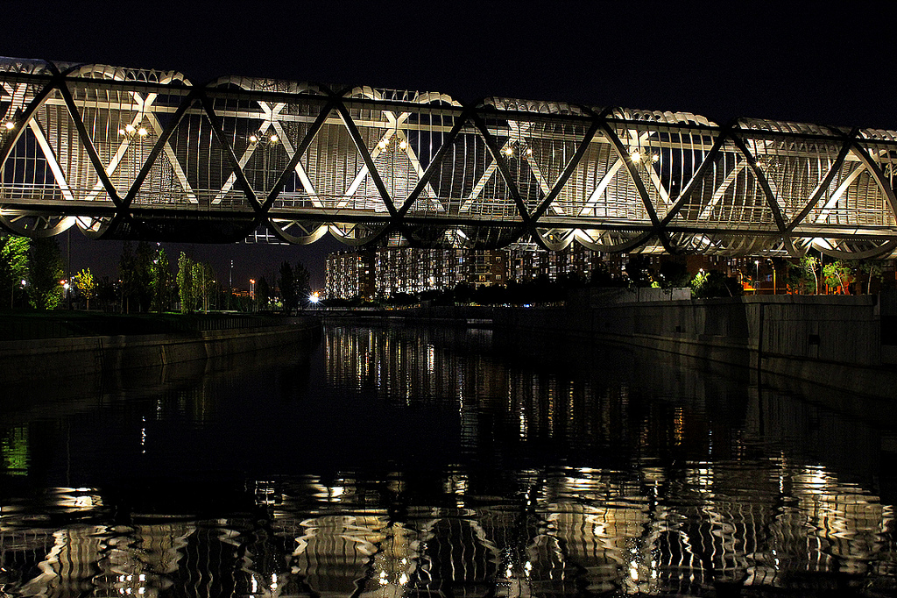
  Bridge to INTERREG EUROPE

Slide 10
INTERREG EUROPE
Context
Overall strategic framework: EU2020 strategy
SMART GROWTH
Economy based on knowledge & innovation
GREEN GROWTH
Resource efficient, greener and more competitive economy
INCLUSIVE GROWTH
High-employment economy delivering social and territorial cohesion
3 pillars translated in 11 Thematic Objectives in 2014-2020 regulation

Slide 11
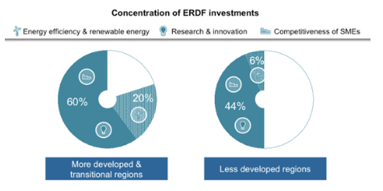


Policy learning among public authorities
to improve performance of policies & programmes for regional development,
in particular Structural Funds programmes

Slide 12
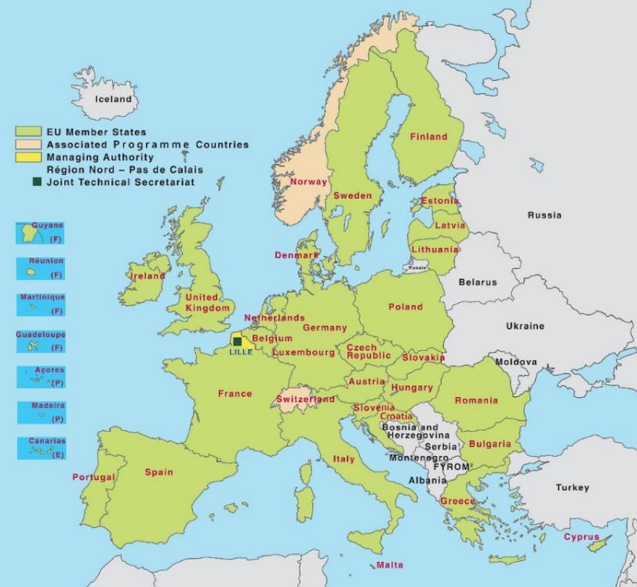
INTERREG EUROPE
Eligible area
EU28 + Norway & Switzerland

Slide 13


INTERREG EUROPE
Thematic focus
4 priority axis

Slide 14


INTERREG EUROPE
2 actions
A. Interregional Cooperation Projects
B. Policy Learning Platforms

Slide 15
INTERREG EUROPE
Projects
Definition
Partners from different countries working together on a shared regional policy issue (within the thematic fields of the programme)…
Objective
….to improve the effectiveness of the policies of the regions involved in the project (in particular their Investment for Growth and Jobs goal programmes)

Slide 16
INTERREG EUROPE
Project organised in 2 phases
Phase 1
(1 to 3 years)
Exchange of experience ending up with the production of 1 action plan / region
Monitoring of the action plan implementation
+ possible pilot actions
Phase 2
(2 years)

Slide 17


INTERREG EUROPE
Projects partnership: who is eligible?
  Public bodies
  (e.g. local, regional, national authorities)
  Bodies governed by public law
  (Directive 2004/18/EC)
  Private non profit bodies
Confirmation of the eligibility status: Partner States’ responsibility

Slide 18
INTERREG EUROPE
Projects partnership features
  From at least 3 countries, from which at least 2 partners from EU-MS
  Lead partner: public or public equivalent only from EU countries or Norway
  Recommendation: between 5 to 10 partners

Slide 19
INTERREG EUROPE
partnership composition
Primary target group: bodies in charge of the policies addressed within the project
If not involved, letter of support required
Creation of one stakeholder group per region

Slide 20

INTERREG EUROPE
Platforms: what is it?
A service provided per priority axis via:
Online collaborative tool
With relevant functionalities
+ Expert team
Content and coordination role

Slide 21


INTERREG EUROPE
Origin
INTERREG IVC capitalisation
exercise
S3 platform
Seville
Objective
Objective: To contribute to policy learning across EU in particular
on Structural Funds implementation
Better exploiting projects’ results
Opening up programme results to anyone interested

Slide 22
INTERREG EUROPE
Platforms
Examples of services
  Advice regional stakeholders and running projects
  Organise and facilitate peer reviews among regions
  Organise and facilitate thematic workshops
  Analyse and disseminate the content of projects through dedicated events & publications
  Facilitate knowledge sharing and networking among regions on the collaborative tool

Slide 23
INTERREG EUROPE
Platforms
Target groups
Stakeholders involved in the implementation of Growth & Jobs or cooperation programmes
Other stakeholders relevant to the topics
Implementation
Sub-contracting arrangement
Through procurement procedure
Launched in the course of 2015

Slide 24
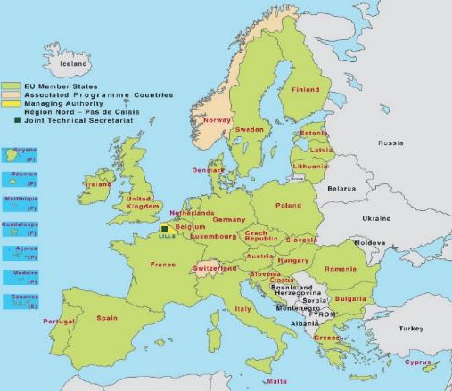
INTERREG EUROPE
2 interrelated actions
Policy Learning Platforms
Open to all regions
Enrich
Contribute
Interregional cooperation projects
Project 1
Project 2
Project 3

Slide 25
INTERREG EUROPE
Funding
  Programme ERDF budget: MEUR 359
    ERDF budget for platforms: MEUR 15.3 (max)
    ERDF budget for projects: MEUR 322.4 equally shared over 4 priority axis (MEUR 84)
  ERDF budget recommended per project:
  between MEUR 1 to 2

Slide 26
INTERREG EUROPE
Co-financing rates | According to legal status or location
85% ERDF | Public or public equivalent from EU
75% ERDF | Private non-profit from EU
50% Norwegian funding | Public, public equivalent and private non-profit from Norway
Swiss funding | Public, public equivalent and private non-profit from Switzerland

Slide 27
INTERREG EUROPE
 | INTERREG IVC | INTERREG EUROPE
Rationale | Regional development policies | Regional development policies, principally SF programmes
Area | EU-27, NO+CH | EU-28, NO+CH
Eligibility | Public & public law bodies No private | Public & public law bodies Private non-profit bodies
Co-financing | 75%-85% (country) | 85% public or equivalent 75% private non-profit
Actions | 1-phase project + CAP | 2-phase project + PLP

Slide 28
INTERREG EUROPE
Next step
1st call for proposals for Interregional Cooperation Projects
Provisional timing:
No thematic restrictions: call open to all Investment priorities
No specific requirement in terms of geographical coverage
One third ERDF budget available: MEUR28 per priority axis
Procedure: on-line system

Slide 29


Slide 30


Zooming in on INTERREG EUROPE

Slide 31
1. Improving Structural Funds programmes
2. Public administrations as main target groups
3. Mobilising stakeholders
4. Capturing results

Slide 32






Slide 33

1. Improving Structural Funds programmes

Slide 34
1. Improving Structural Funds
ERDF + ESF = Structural Funds + Cohesion Fund = The Funds + EAFRD + EMFF = ESI Funds (European Structural and Investment Funds)

Slide 35

1. Improving Structural Funds
Why? rationale
Objective set in the ETC Regulation - Article 2(3)(a) for interregional cooperation:
  ‘to reinforce the effectiveness of cohesion policy’
  ‘identification and dissemination of good practices with a view to their transfer principally to operational programmes under the Investment for growth and jobs goal but also, where relevant to cooperation programme’

Slide 36

Goal 1:
Investment for growth & jobs
EUR 340 billion
Goal 2:
European Territorial Cooperation
EUR 10.2 billion
INTERREG EUROPE
EUR 359 m

Slide 37
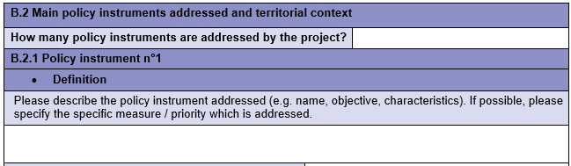
1. Improving Structural Funds
How is it reflected at project level?
Policy instruments addressed to be specified in application form
At least half of the policy instruments addressed by a project need to be related to Structural Funds programmes

Slide 38
1. Improving Structural Funds
How do you improve policies?
Support new projects
Change programme governance
Change programme structure

Slide 40

2. Public administrations as main target groups

Slide 41
2. Involving policy makers
Why? Rationale
INTERREG EUROPE: dedicated to improving policy instruments
Public administrations: organisations responsible for policy design and implementation
Public administrations: core target group of INTERREG EUROPE

Slide 42
2. Involving policy makers
How is it reflected at project level?
Participation of public administration: pre requisite
e.g. When Structural Funds programme addressed,
Managing Authorities (MA) / Intermediate Bodies (IB) should be involved
If organisation responsible for the policy instrument addressed is not a partner, it should provide a letter of support

Slide 44


Slide 45

3. Mobilising stakeholders

Slide 46
3. Mobilising stakeholder
Why? Rationale
4 levels of learning in interregional cooperation
3. Regional stakeholders learning
2. Organisational learning
4. External /
EU level learning
1. Individual learning
Key success factor to interregional learning: to go beyond individual / organisational learning

Slide 47
3. Mobilising stakeholder
How to optimise learning?
Creation of stakeholder groups:
1 group per partner region
Members:
  organisations competent in the field tackled by the project (e.g. for innovation: research centres, universities, agencies, SMEs)
  body in charge of policy instrument addressed (in case this body is not a partner)
Involved in the interregional learning process

Slide 49

4. Capturing results

Slide 50
4. Capturing results
Why? Rationale
Importance to demonstrate results beyond policy changes
Impacts of cooperation can take time
Tackle the pilot action ‘paradox’: pilot action cannot be known at the application stage

Slide 51

4. Capturing results
Projects: structure and duration
Implementation in 2 phases
Phase 1 From 1 to 3 years
Phase 2 Fixed to 2 years
Maximum duration: 5 years

Slide 52
4. Capturing results
Projects: structure
Phase 1
‘Interregional learning’
Interregional exchange of experience
e.g. seminars, workshops, site visits, staff exchanges, peer reviews
1 Action Plan per region
Measures to be implemented
Timeframe
Work steps
Responsible players
Costs and funding resources (if applicable)

Slide 53

4. Capturing results
Projects: structure
Phase 2
‘Monitoring the action plan implementation’
Monitor the implementation of the different action plans
Pilot actions (only in justified cases)

Slide 54
4. Capturing results
Insight into phase 2
Primarily dedicated to monitoring the Action Plan implementation
Activities pre-defined by the programme (i.e. 2 partner meetings, 1 dissemination event, website update and reporting activities)

Slide 56

  Support for projects

Slide 57
  Support for projects
Partner search tool
Project idea database
Programme feedback
Events

Slide 58
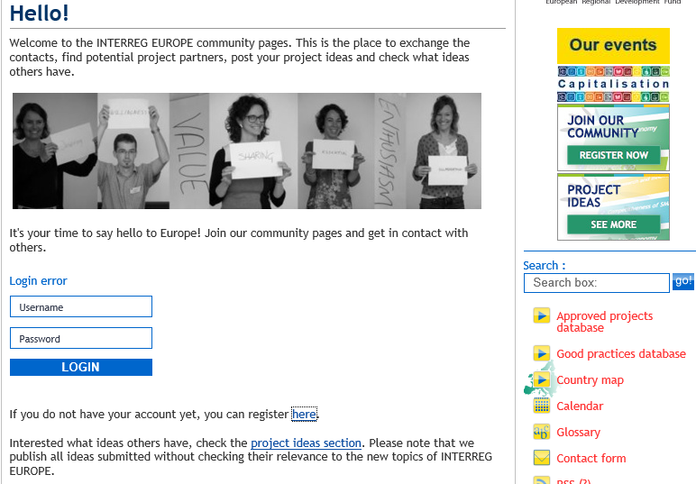
  Support for projects

Slide 59
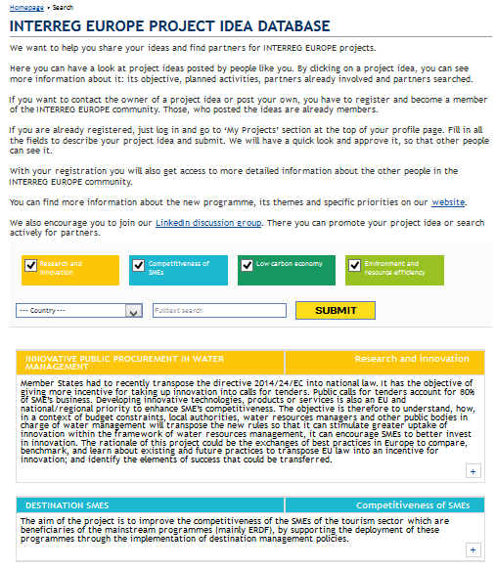
  Support for projects

Slide 60
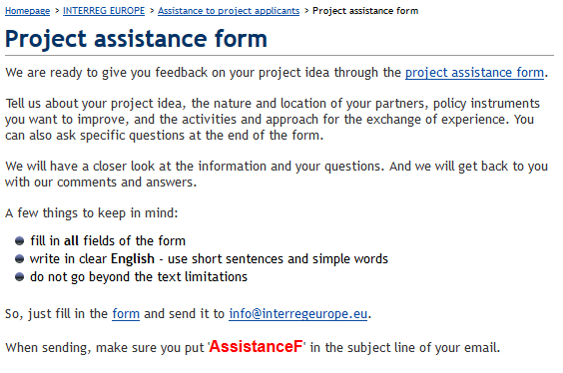
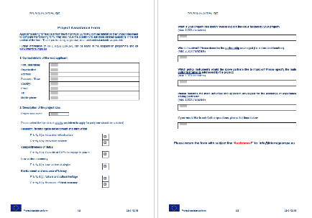
  Support for projects

Slide 61
  Support for projects
National information events
For local participants
Information about the programme & funding opportunities
Inspiration from local project partners
Lead applicant seminars
2 events per call for proposals
  (May – June 2015, tbc)
For lead applicants in projects
Guidance for submitting the application
Usually with individual consultations

Slide 62
  Support for projects
Partner search Forums
Existing EU networks
Eurocities, Eurada, ERRIN, FEDARENE, CPMR…
National Contact Points

Slide 63




  Support for projects
interreg4c.eu/interreg-europe
interregeurope.eu
facebook.com/interregeurope
twitter.com/interregeurope
changing-regions.eu

Slide 64
  Support for projects
Project assistance form available online
Scheduling for individual consultations open
mid-January 2014
National information days
Individual consultations
1st half 2015
March 2015
Information campaign on First call
May/June 2015
Lead applicant seminars
First call for project proposals closed
Submit application
mid-July 2015

Slide 65

  Q&A panel

Slide 66

Thank you for your attention!

