Slide 1


National Info day Spain
Open Call for proposals
Euro-MED04
Thematic projects : TEST or TRANSFER
08 April 2024
VICEPRESIDENCIA
PRIMERA DEL GOBIERNO
MINISTERIO
DE HACIENDA
Notes:
Tools : Manual – AF – ToRs
Mandatory activities
Guiding Principles
Tips
Application steps

Slide 2
Agenda
Programme presentation
Call04 presentation
VICEPRESIDENCIA
PRIMERA DEL GOBIERNO
MINISTERIO
DE HACIENDA
Notes:
The Programme in a nutshell
Call04 main features

Slide 3
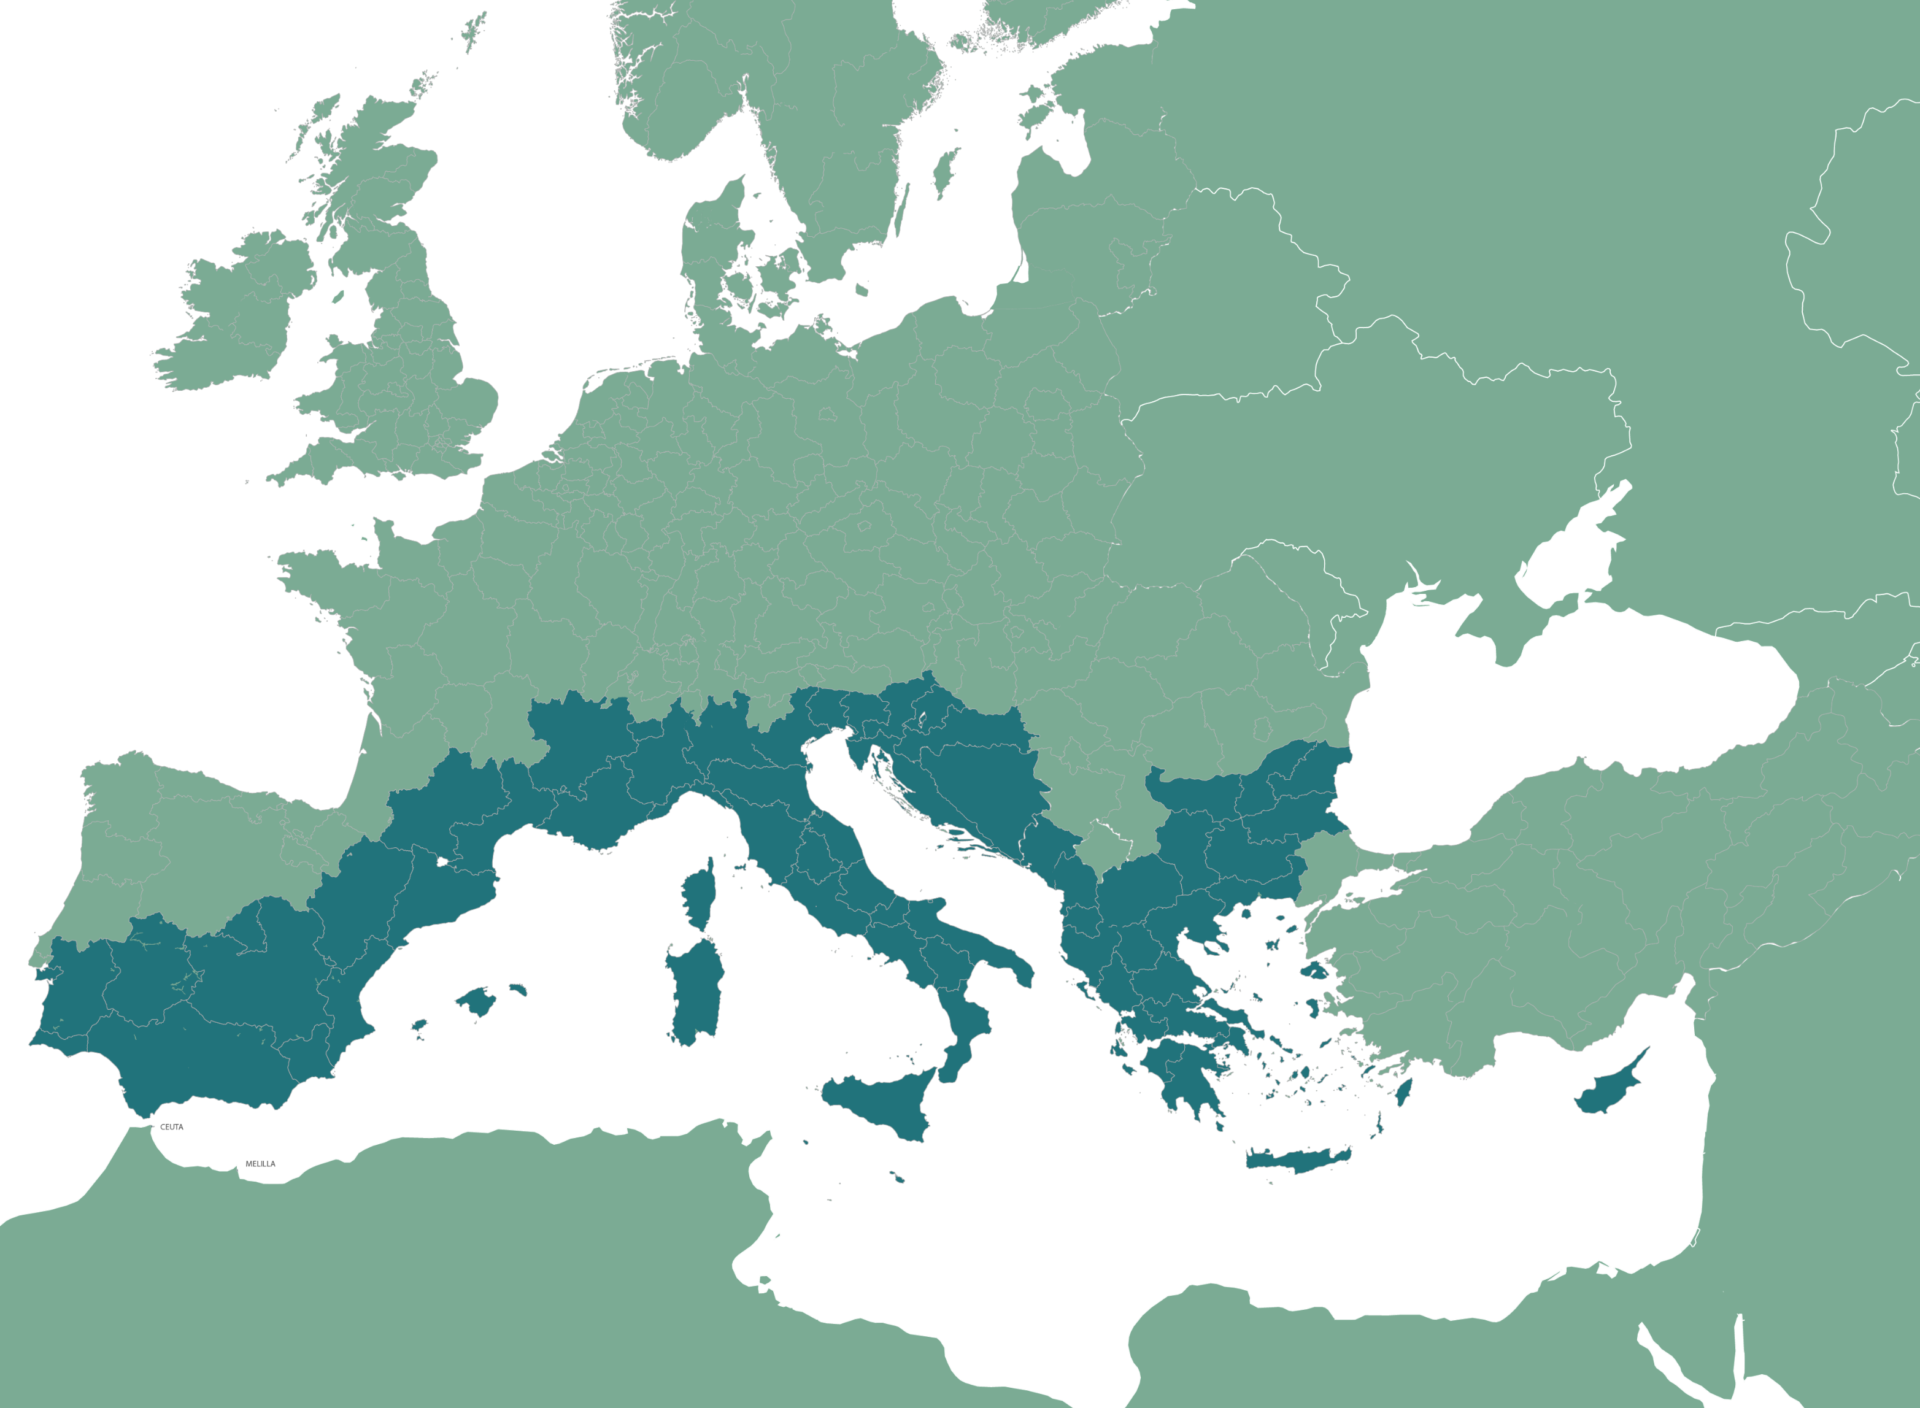










The Interreg Euro-MED Programme
69 regions, 14 countries
294M€

Slide 4




Fields of intervention: 3 priorities, 4 Missions
Smarter Mediterranean
Strengthening an innovative sustainable economy
Protecting, restoring and valorising the natural environment and heritage
Promoting green
living areas
Enhancing
sustainable tourism
1.1
Consolidating a competitive innovation ecosystem
Not in
this call !!!
1.1
Consolidating a competitive innovation ecosystem
2.4
Promoting climate change adaptation and risks prevention
2.4
Promoting climate change adaptation and risks prevention
2.6
Supporting circular economy
2.6
2.7
Greener Mediterranean
Supporting circular economy
Enhancing Nature & biodiversity
2.4
Promoting climate change adaptation and risks prevention
2.7
Enhancing Nature & biodiversity
Better Mediterranean Governance
6.6
A better cooperation governance

Slide 5
Call for Proposals Euro-MED04
Thematic projects
VICEPRESIDENCIA
PRIMERA DEL GOBIERNO
MINISTERIO
DE HACIENDA

Slide 6



Projects main features
Only test or transfer projects!!
Applications for transfer projects are strongly encouraged.
Total budget and duration (implementation + closure activities)
Max: 1.5M€ Max. 2.5M€
27 months 33 months
Partners from Euro-MED regions of 5 countries minimum
Starting date of the activities: 1st April 2025
An indicative financial allocation of around 11 M€ per Mission and an estimated number of 5 projects per Mission are foreseen for this call.
Notes:
The projects duration depends on the category of project.
Each pictogramme here refers to a category of project: test, transfer.
Project duration includes, and this is new in this programming period, both the implementation and closure activities. Closure activities include the submission of the final report and final payment claim to the Joint Secretariat.
We plan a starting date on the 1st of April 2025, if everything goes well!
The total budget allocated to the Call is 44M€ (11M€ per mission, approx. 5 projects per mission).

Slide 7




Missions main focus under Call 04
- Topics supporting the development of a sustainable and efficient bioeconomy: use of renewable biological resources from land and sea to produce food, materials, and energy.
- Climate change adaptation and risk prevention and management.
- Protection and preservation of natural resources, and restoration of degraded and polluted ecosystems.
- Improved implementation and enforcement of environmental policies/legislations.
- Urban regeneration: heat island effects, water cycle management, integrated renovation of buildings and housing stock. Energy efficiency is a priority.
- Adaptation, rather than mitigation.
- Need to integrate the quality-of-life dimension with a holistic approach and citizen engagement.
- Resilience of destinations and promotion of regenerative tourism.
- Resource efficiency and circular transition in the tourism sector and destinations.
- Smart and sustainable ecotourism, using advanced technologies.

Slide 8
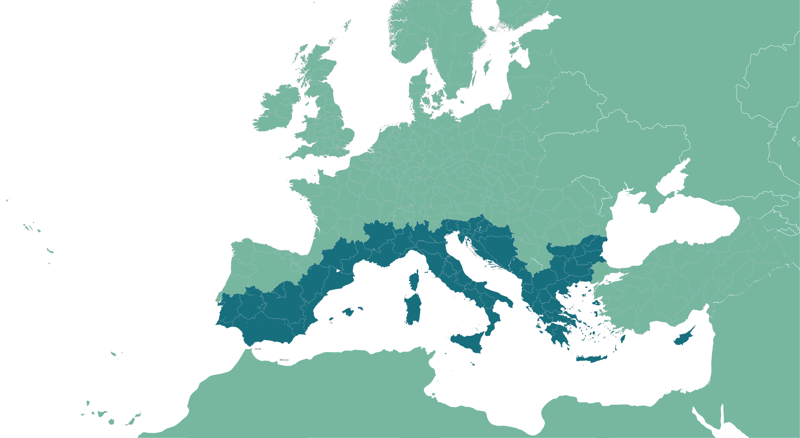
Expected partnership – eligibility criteria
As a minimum, the project partnership must be composed of organisations based in five (5) different countries within the Interreg Euro-MED cooperation area (eligibility criteria B.1)
The LP is a public body, or a body governed by public law (as defined in Directive 2014/24/EU) (eligibility criteria B.2)
At least 2 partners are based in an EU region of the Programme cooperation area
Private institutions from IPA countries must be non-profit
Associated partners are not counted in the partnership composition but can have their travel and accommodation expenditures reimbursed.
Organisations from IPA countries can be Lead Partners!
Reference documents:
Terms of Reference (Annex I)
Programme Manual
Notes:
A minimum of 5 countries from the Interreg Euro-MED cooperation area (eligibility criteria B.1) This means IPA or ERDF partners located in regions among the 69 composing the Programme cooperation area.
The LP is a public body, or a body governed by public law (as defined in Directive 2014/24/EU) (eligibility criteria B.2) located in the cooperation area.
A note - partners from IPA countries can now apply as LP in this Call!
There is no limit set for participation per country for this call but transnationality will be assessed.

Slide 9

Eligibility of expenditures
Preparation costs – lump sum of €37K for each project
Staff costs – full time (100%) or part-time (fixed %)
Office & administrative – flat rate – 15% of staff costs
Travel & accommodation – flat rate – 15% or 22%* of staff costs
External expertise & services
Equipment
Infrastructure & works (only for pilot testing)
Notes:
*IPA countries

Slide 10
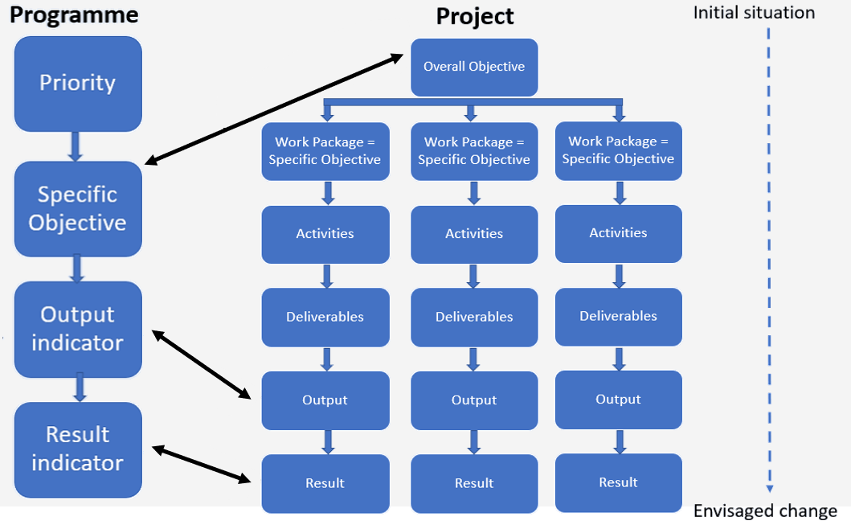
Intervention logic – outputs and results
Notes:
This is the Programme Intervention logic scheme, we find there our Indicators
They are linked to the projets
Project’s outputs must contribute to the Output Indicator of the Programme
Project’s results must contribute to the Results Indicator of the Programme
To do this, they must have the same measurement unit and must be able to be aggregated on project AND Programme level

Slide 11
Intervention logic – outputs and results
Project
Programme
OUTPUT INDICATORS
RCO83 – Strategies and action plans jointly developed
RCO116 – Jointly developed solutions
RCO87 – Organisations cooperating across borders
OUTPUTS
Strategies and action plans
Solutions
Cooperations
RESULT INDICATORS
RCR79 – Joint strategies and action plans taken up by organisations
RCR104 – Solutions taken-up or up-scaled by organisations
PSI1 – Organisations with increased institutional capacity due to their participation in cooperation activities across borders
Notes:
Now, what are exactly the indicators considered in this call ?
For the Programme, the Outputs indicators are namely the XX (strat&action plan, solutions, organisations)
As for the Results indicators we have XX
As you can see, Output corresponding to Strategies and action plan (RCO83) will directly contribute to Result corresponding to Strategies and action plan taken up by organisations (RCR79)
Same thing for the 2 other types of outputs and Results
Once again, eveything is linked
ANIMATION
That means that at the project level, their outputs provided being Strategies and action plans will contribute to RCO83 and RCR79
The ones provided as solutions will contribute to indicators RCO116 and RCR104,
And finally outputs corresponding to cooperations between organisations will contribute to indicators RCO87 and PSI1

Slide 12





Continuity
When drafting the proposal, please consider the main results of the Interreg MED projects funded during 2014-2020
And the projects funded under the Call02 for Thematic projects that started on 01/01/2024
Notes:
Common to all Mission, an important point for this call is the Continuity with the work done by the Interreg MED Programme 2014-2020 on the environmental dimension
Project proposals have to consider the previously implemented projects. : Interreg MED (interreg-med.eu) and in particular the results listed in the Terms of Reference.
But also consider the newly approved projects of this period 21-27.

Slide 13

Complementarity
Interreg Adrion, NextMed, Marittimo…
DG MARE…
Eusair, Eusalp…
UfM, Westmed, Bluemed…
Any results or tools from other initiatives, strategies and Programmes…
SPECIAL FOCUS on results from :
PRIMA/Horizon Europe
LIFE
EMFAF
And the link to Smart Specialisation Strategies (S3)
Notes:
However, Many stakeholders in the Mediterranean share the same challenges.
So, projects should integrate in the design of the proposal the complementarities with other initiatives, strategies and programmes’ priorities focusing on similar challenges.
This is part of the Programme’s ambition of establishing synergies beyond its geographical limits.
In the screen you can see some of those strategies. A special focus is put on results from Prima/Horizon, Life, Emfaf and on the synergies with S3 in this Call.

Slide 14
Approved projects under Call 02
AZA4ICE
BLUE ECOSYSTEM
CARBON FARMING MED
CircleMED
Clepsydra
eWAsTER
GREENSMARTMED
OliveOilMedNet
ProcuraMED
REPper
REVIVE
SPOWIND
VERDEinMED
ARTEMIS
CARBON 4 SOIL QUALITY
COASTRUST
FRED
Germ of Life
GreenList4MMPAs
LocAll4Flood
MedSeaRise
MPA4Change
StrategyMedFor
TREASURE
WE GO COOP
Wetland4Change
Streets for Citizens
ArtMED
BauNOW
BAUHAUS4MED
CO2 PACMAN
E-MED
EnerCmed
GARDEN
GREENMO
INFIRE
LOGREENER
MED COLOURS
NUDGES
ProLIGHTmed
RECinMED
ReMED
RENEWPORT
RuralMED Mobility
URWAN
COOL NOONS
HERIT ADAPT
LIBECCIO
MAST
MedDiet Go
MED-GIAHS
MED-Routes
NaTour4CChange
SMITour
TOURISMO
What we do - Programme Interreg Euro-MED (interreg-euro-med.eu)
Notes:
A brief overview PER MISSION : 56 projects started in January 2024
More details, including summaries on our website
The idea is to have different but complementary proposals than the already selected ones

Slide 15



Compulsory activities: Coordination with Governance projects
Institutional
Dialogue
Projects
Thematic
Community
Projects
Thematic Projects
Notes:
The Gov projects (TCP and IDP of each mission), aim to amplify the results of the thematic projects, not individually, but rather in combination with the results of other projects.
To this end, the gov projects will implement, and particularly the Thematic Community projects, activities focused on sharing, exchanging, and developing synergies between projects under the same mission.
This implies your active participation and investment in the activities of the governance projects.
This dimension must be integrated, and a part of the budget must remain flexible to allow at least the following activities (next slide).

Slide 16




Compulsory activities: what is foreseen with TCP
F2F meetings
Thematic
Community
Projects
Thematic Projects
Joint events
1 video of project
Training material
Notes:
It should at least be foreseen with the TCP :
face to face meetings involving the Lead Partner and one communication/capitalisation officer
Participation to 1 joint communication event during the project lifetime
1 short (1’) video presentation of the project,
Pedagogical material to feed the Euro-MED academy that will serve as a training platform to support the dissemination and transfer of knowledge and results.

Slide 17

Compulsory activities: according to GP’s strategies
Database: provide relevant information to feed the databases developped
Working groups: participate in clustering process, development of synergies, collective thematic work (surveys, review of documents, provision of examples, etc.)
Networking activities (in addition to mandatory joint event): participate in events for collective dissemination, transferring and integration processes
Joint capacity building activities: participate in content developement and or participate in training/mentoring/support processes offered by TCP
Transferring potential: provide information to enable proper analysis of replicability, transferability and integration potential of project results
Mainstream support: share previous experiences and mainstream methodologies
Notes:
And as well, according to the Governance project’ strategies, some resources could be dedicated to Thematic developments and policy uptakes, such as :
Providing relevant information to feed the databases developed;
Participating in different working groups to develop specific work
Participating in other’s projects events
Participating in trainings support processes
Providing information to enable proper analysis
amplify and mainstream the results of the projects.
For more details on activities to be foreseen, please refer to the Programme Manual, “Designing the project activities” and “Drawing up my budget” sections.

Slide 18
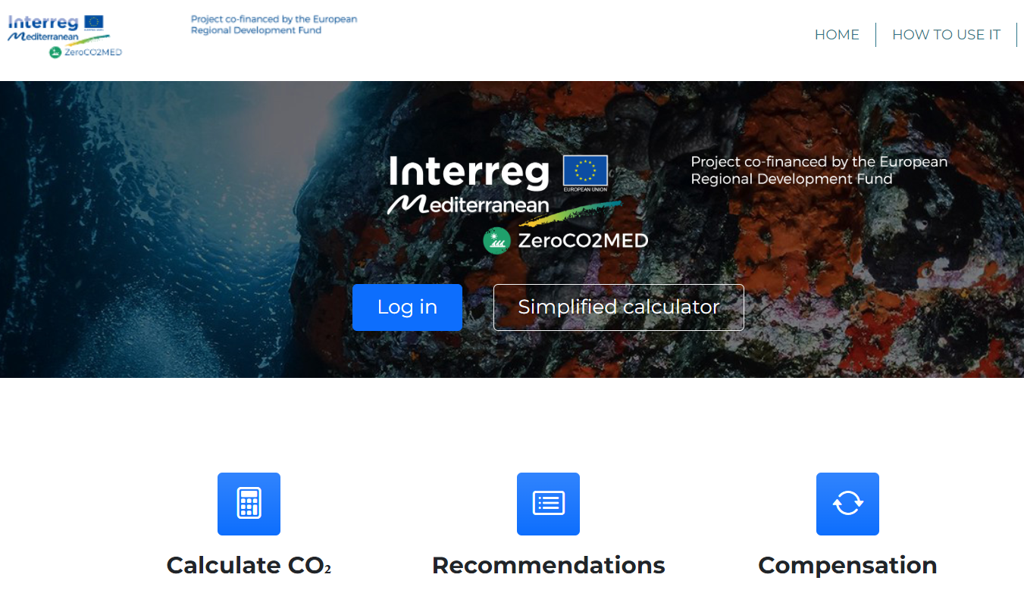
Compulsory activities: Monitoring the project carbon footprint
Step 1: reduce project carbon footprint by design!
Step 2: calculate the project carbon footprint
Step 3: reduce your project emissions when feasible
HOW?
Methodology for calculation
Online tool used for the monitoring and calculation of carbon emissions
A range of recommendations for reduction
https://carbonfootprint.interreg-euro-med.eu/
Notes:
The carbon footprint monitoring:
As a general rule, projects must first think of reducing carbon footprint from the designing phase of the project (e.g. choosing activities that emit the least)
By using the simplified calculator : website address
In addition, projects have to include one activity to calculate their carbon footprint. Projects shall use the methodology(ies) and tool(s) proposed by the Programme (same website but logged in)
As compensation is difficult within project lifetime, compensation actions at the level of the Programme is under reflection.

Slide 19
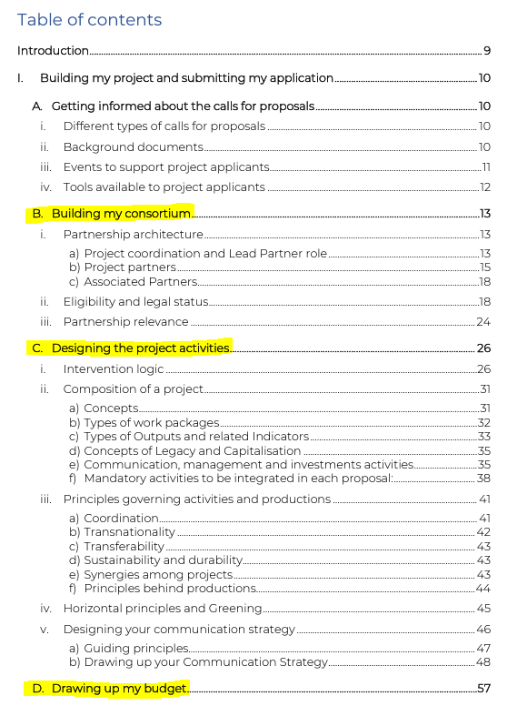
The Programme Manual:
your coffee table book
programme-manual_v.1.8_en.pdf (interreg-euro-med.eu)
Notes:
First thing to produce a good quality proposal is to read the Programme manual
Here is the Table of content. It provides very useful details on what is expected, especially :
Consortium : XXX.
Activities : XXX
Budget : Because the planned activities, deliverables, outputs and results, as well as the number of partners must be taken into account when developing the budget.
And you will find also the guiding principles to apply for a reasonable and realistic budget (Economy, Efficiency, Effectiveness)
Restrictions can be applied and specified in each ToRs, (for instance on number of PPs expected) but this is where you’ll find the general idea

Slide 20
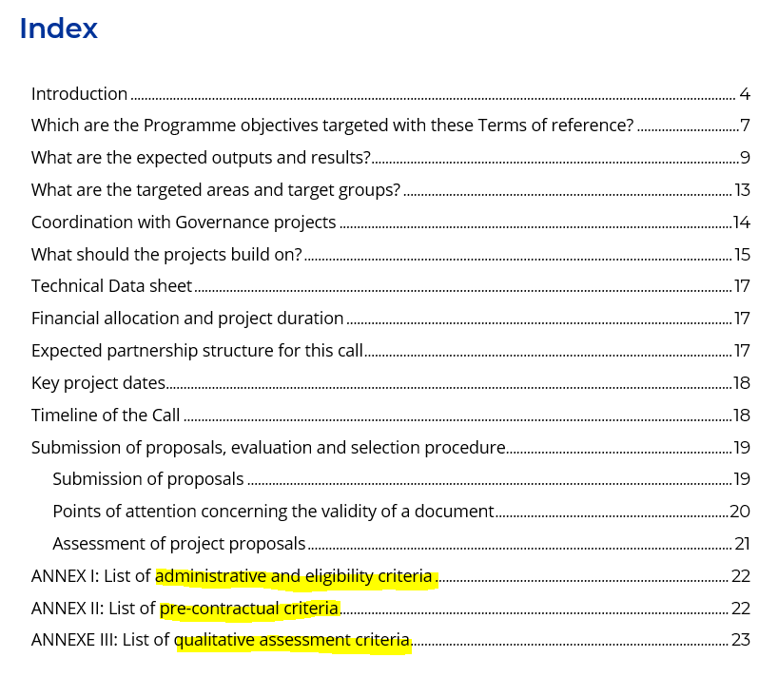
The Terms of Reference :
your self-assesment tool
Notes:
the Terms of Reference
A focus on Annexes :
Annex I : eligibility (submitted on time, number of countries represented, status of LP…)
Annex II : if your project is approved, you must comply to the pre-contractual criteria to definitely validate the approval. It is good to anticipate what will be requested (proof of partner eligibility in case of out Euro-Med area)
Annex III : it includes the questions the assesor will answer on the basis of what’s in the AF. Make sure the searched information is clearly present in you application.
Namely on the Project relevance – Cooperation character – Intervention logic – Partnership relevance – Horizontal principles – Work plan – Budget
We recomend you to make a self assesment with Annex 1 and 3of your project before submitting it, to see is nothing is missing
That’s it for the unavoidable tools. Now a focus on the work plan content and the mandatory activities

Slide 21
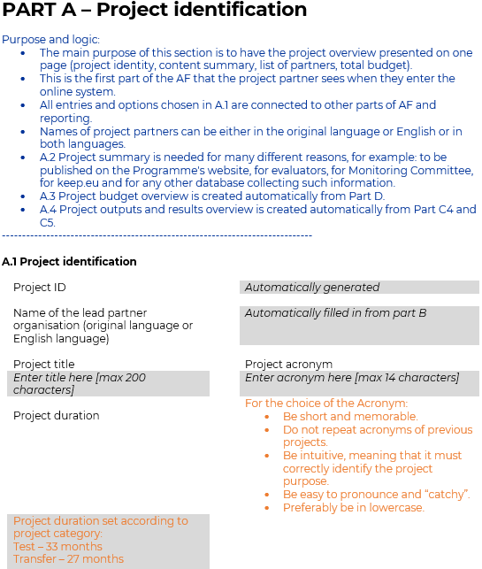
The courtesy AF: your playground
Notes:
The Courtesy AF, available on our website.
It takes back all the AF sections, but with explanations on how to fill it in
And advices to be as clear as possible

Slide 22
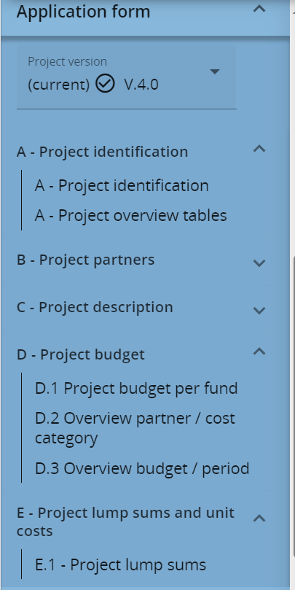
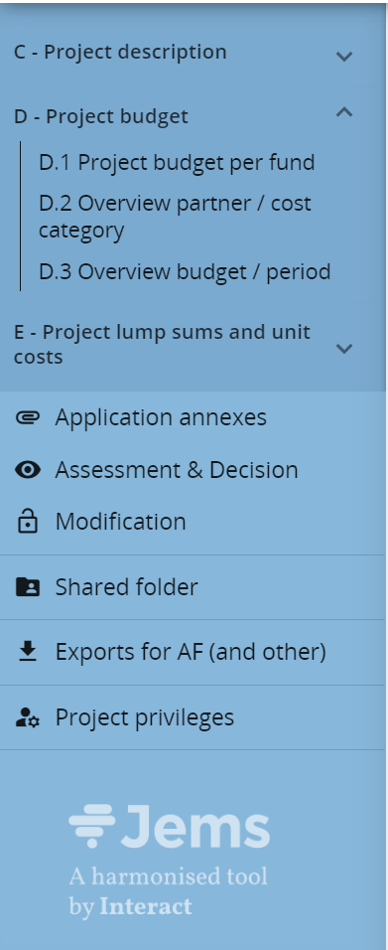
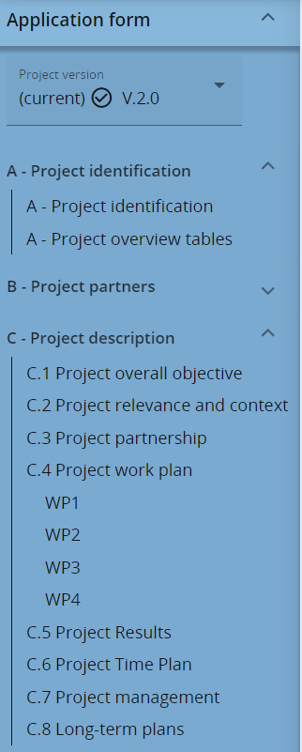
Jems AF: the structure of your idea
Notes:
In blue is the structure of the AF you will find in Jems, the online tool to submit your proposal
It is important to have a clear picture of what is concretely asked.
Description of each section:
This is all the data you will have to gather among partners
And the project logic you will have to demonstrate, to fit with the call expectations

Slide 23
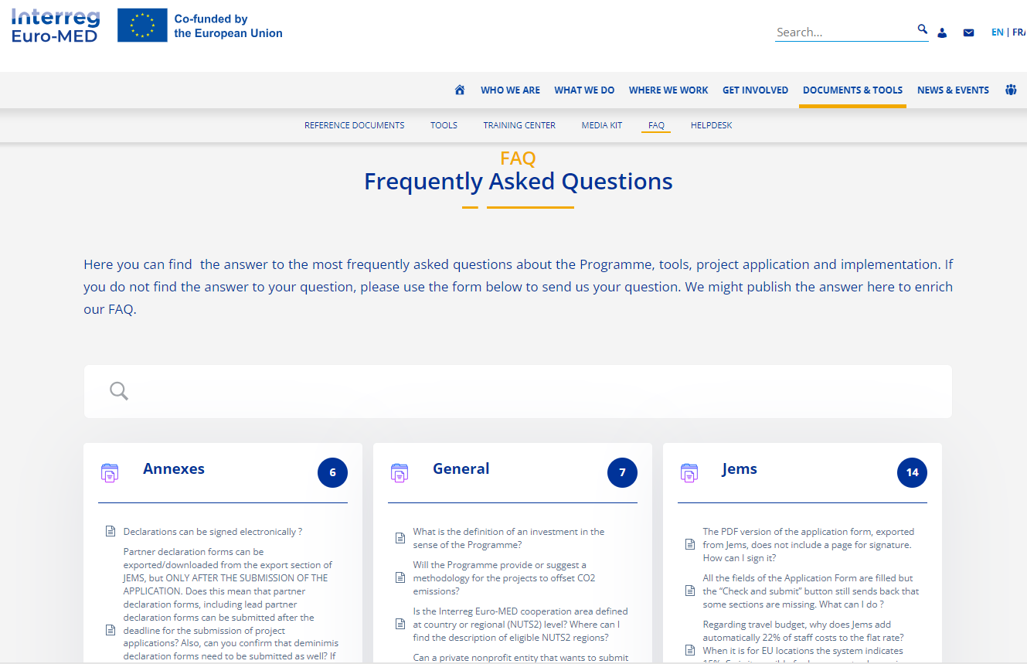

And for any doubts, the FAQ
Centre de ressources - Programme Interreg Euro-MED (interreg-euro-med.eu)
Notes:
Find answers to your questions
In different categories
If you can’t find your answer, ask your question on the helpdesk
Follow the workflow of your question in: https://interreg-euro-med.eu/en/support-desk/
We won’t reply to direct emails!

Slide 24


Convince your reader
  Be Consistent with the call objectives, the actions, the budget, the partnership…
  Do’s : read the intervention logic
  Be Concrete. Answer the question « How could my project lead to a concrete change » ?
  Do’s : « By increasing the fraction of recycled plastic waste, the project will substancially reduce plastic waste generation from X tons of plastic used per year to X tons ».
  Be precise and straightforward
  Do’s : « By promoting the restoration of water polluted environments, the project will contribute to goal 6 of the UN sustainable development »
Notes:
Here are some tips to also consider for the construction of your proposal.

Slide 25
TIPS per section
    Project relevance : show clearly the need tackled
    Cooperation character : transnationality must be essential to reach results
    Intervention logic : must be concrete/direct/coherent
    Partnership relevance : careful to geographical balance, skills, roles dispatch
    Horizontal principles : show contribution with concrete examples
    Work plan : objectives (=WP) must be operational and well sequenced
    Budget : well shared and reflecting the activities
Follow technical meetings for more details !
Notes:
1 : Link project territorial challenges to the ToRs and specific focus of the Call / Reference and specify concrete contribution to all levels of policies / Specify concrete use of available knowledge and existing results and practices
2: Demonstrate transnational approach and transnationality of activities
3: In the Intervention logic: be concrete and direct / Clarify objectives – results - outputs (deliverables) / Contribute to Programme output indicators
4 : A strong partnership : Geographically balanced / Matching project objectives with partnership skills / Mixing institutional and operational roles / Thinking, enabling and supporting transfer / Ensuring capitalisation / Strong policy vision
5 : Horizontal principle: You can refer to the SDGs in this section.
6 :Understandable / Measurable / Reachable / Transferable /coherent project timeline. Must see the concrete roles for all : who will do what. Careful to the balance staff costs/external expertise
7 : realistic and balanced.

Slide 26
Application and selection procedure
Projects appraisal
The administrative and eligibility check
Quality assessment criteria (1 phase)
Pre-contractual criteria
Quality Assessment in 1 phase on :
    project relevance,
    cooperation character,
    intervention logic,
    partnership relevance
    horizontal principles,
    work plan,
    budget
Rating based on 50 points (35 out of 50 at least to be requested for being eligible to approval, depending on available budget)
Notes:
The evaluation process :
After the closure of the call and the reception of the proposal, the selection procedure will start. In the screen you can see the main stages.
Project assessment is based on 3 main steps: each one of them can lead to the rejection of the proposal
Firstly, we have the Administrative and eligibility check, which are the key technical aspects to consider your proposal receivable
Quality assessment:
The content of the project proposal is evaluated form the quality point of view. Projects will be selected, taking into consideration their score (in descending order), positions of each national delegation and budget availability for the call. The assessment will be made in 1 phase this time.
Following the assessment of all proposals, these are ranked according to their score, per mission. A final decision on project approval or rejection is taken by the Programme Committee. Based on their overall score and final ranking, the proposal with the best score per mission will be approved.
Assessment material is available in the ToRs
The threshold for projects to be recommended for approval to the Programme Committee by the Joint Secretariat is of 35 out of 50.
Pre contractual criteria concern approved projects. A deadline of 2 months after approval is given for submitting key additional information or documents, if needed.
Letters of commitment are no longer an eligibility criterion but a pre-contractual criterion. (presence, mistakes and completeness are not an eligibility criterion)

Slide 27



Key documents composing a proposal
APPLICATION FORM to be filled-in in Jems (English or French) and submitted
MANDATORY ANNEXES : partners (incl. LP) and associated partners declaration
generated from the Jems system and signed
Two consecutive stages:
Application Form, to be validated in Jems before 12/06/2024, at 13.00 (Brussels time)
Mandatory annexes:, to be uploaded in Jems before 26/06/2024 at 13.00 (Brussels time).
Reference documents:
Programme Manual
Terms of Reference ( Annex I)
Jems Guidelines
Notes:
Project applications are 100% dematerialised and must be submitted online at the following address : https://jems.interreg-euro-med.eu/
In this webpage you will find the application form, to be validated before 12/06/2024, at 13.00 (Brussels time).
The courtesy application form, providing some guidance will be available in the website of the programme.
Once the AF has been submitted, the mandatory annexes will have to be uploaded on Jems before 26/06/2024 at 13.00 (Brussels time)
Those annexes include:
partners (incl. LP) and associated partners declaration generated from the Jems system and signed

Slide 28

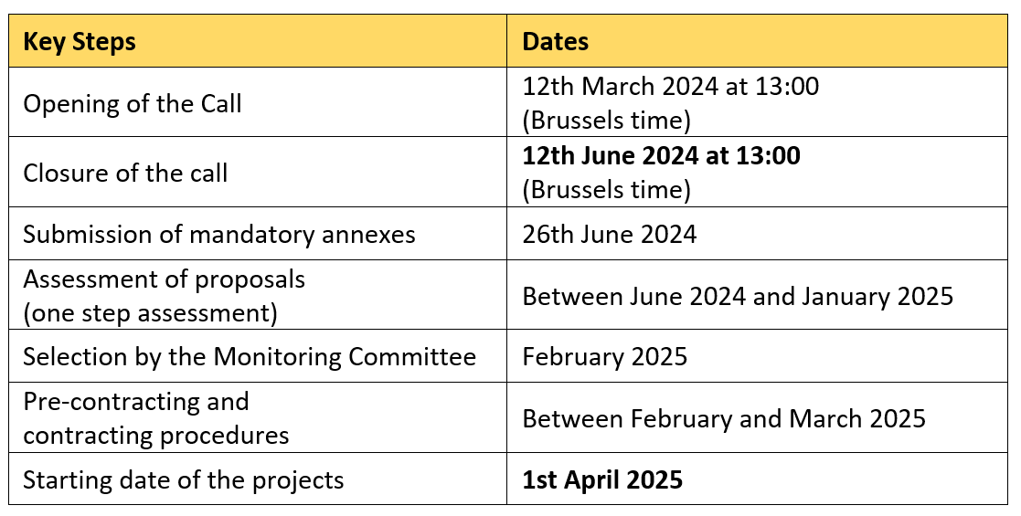
Calendar

Slide 29
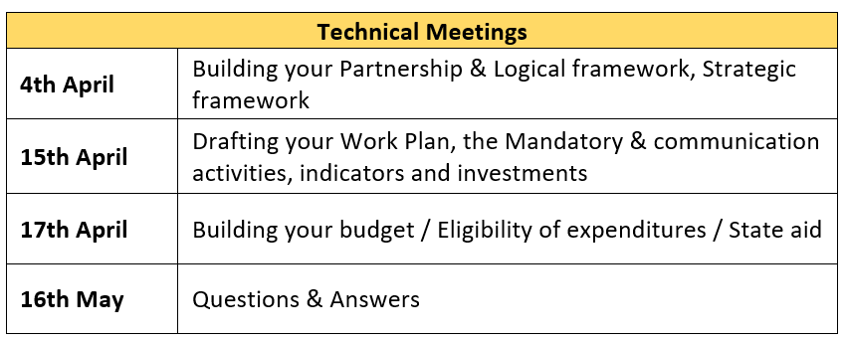
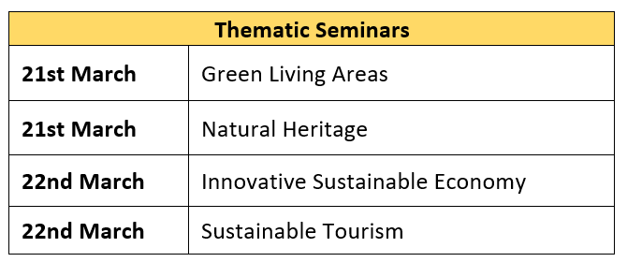
Webinar
https://interreg-euro-med.eu/en/news-events/events/

Slide 30
Point of contact
assistance

Slide 31
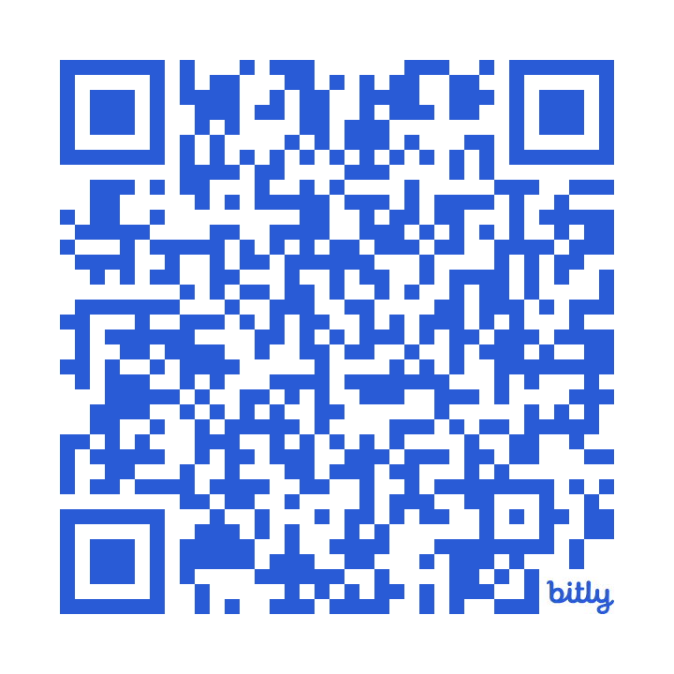
Contacts
Joint Secretariat:
National Contact Point:
Ministerio de Hacienda - Dirección General de Fondos Europeos - Subdirección General de Cooperación Territorial Europea
Paseo de la Castellana, 162 planta 20 – 28071 Madrid
https://www.fondoseuropeos.hacienda.gob.es/sitios/dgfc/es-ES/Paginas/inicio.aspx
https://interreg-euro-med.eu/
Notes:
Programme: Everything you need to know is on our website – You will find information, timeschedule and very useful documents.

Slide 32
Point of contact assistance
General information on the programme and the call for projects
Infodays
Workshops for beneficiaries and first level controllers
Information on the Spanish Control System

Slide 33
Point of contact assistance
Mª Carmen Hernández Martín
cte@sepg.hacienda.gob.es
Mª Teresa Tello Naya mttello@sepg.hacienda.gob.es

Slide 34
THANK YOU and GOOD LUCK!
VICEPRESIDENCIA
PRIMERA DEL GOBIERNO
MINISTERIO
DE HACIENDA

